Slide 1
Data visualisation principles for Power BI
Flavio Meneses

Slide 2
Intro
I’m Flavio Meneses, originally from Portugal and living in the UK since 2014
Microsoft Certified Data Analyst Associate
Co-founder Birmingham Power BI Meetup #PBIbrum
Principal Consultant & BI Developer at Assystem

Slide 3
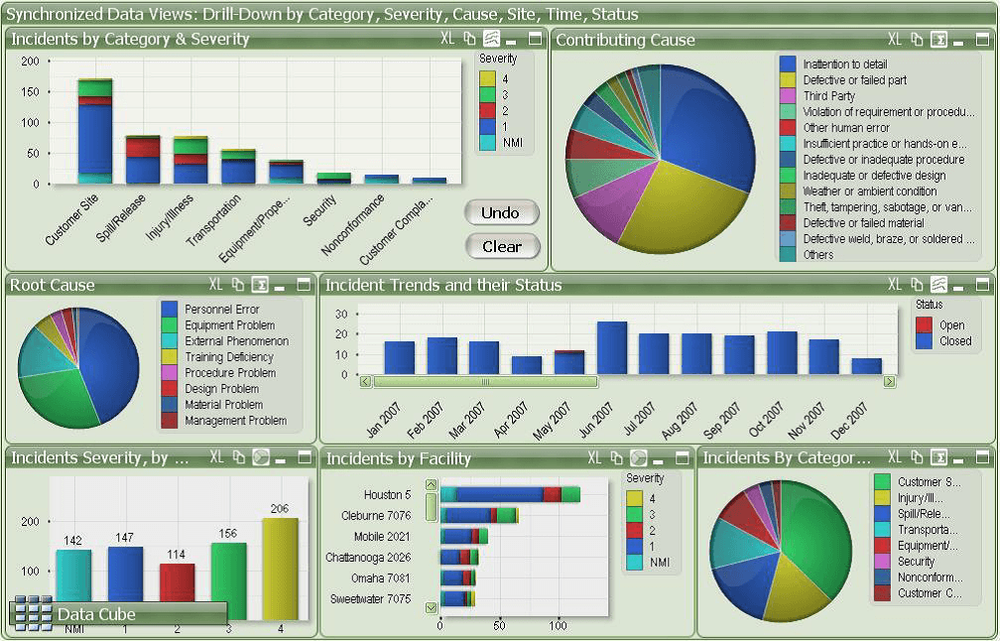
Good or bad design?
Source

Slide 4
Report design principles
1. Floor plan
2. Foundation
3. Finishes
Icons sources: 1, 2, 3

Slide 5
1. Floor Plan

Slide 6
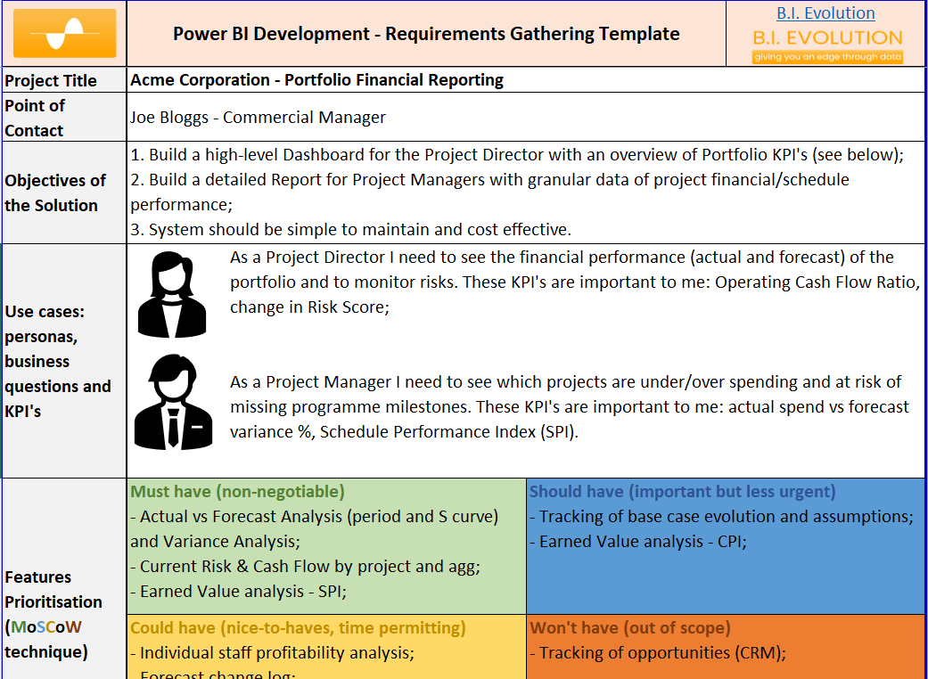
Gather Requirements
Source

Slide 7
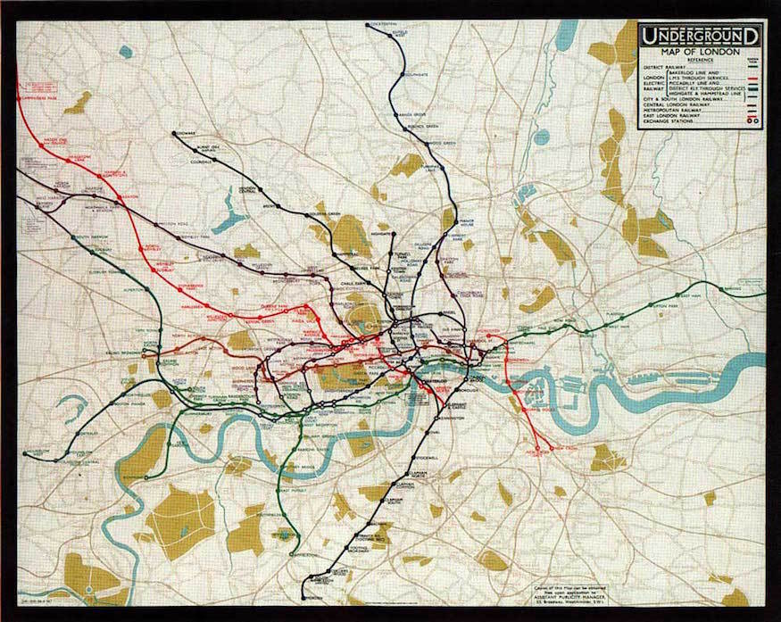
Gather Requirements
Tube map c.1908
Source

Slide 8
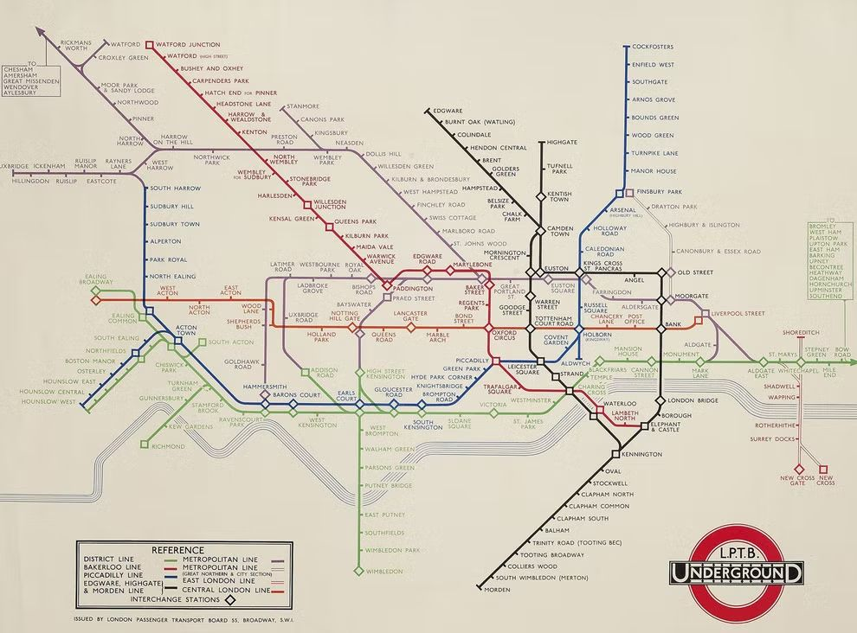
Gather Requirements
Harry Beck’s map 1933
Source

Slide 9
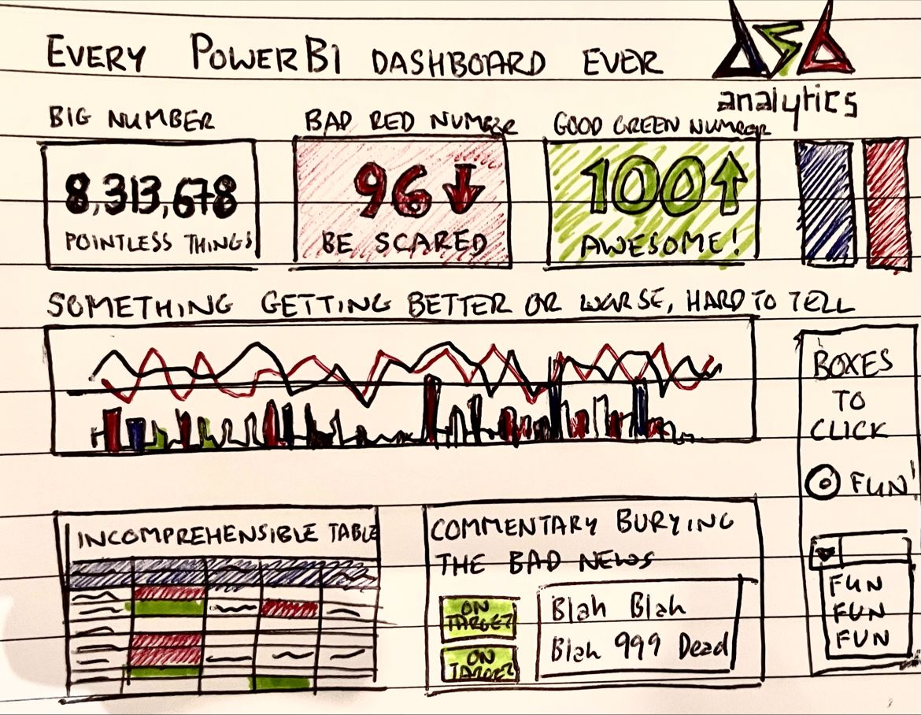
Wireframing
Credit: David Smallbone

Slide 10
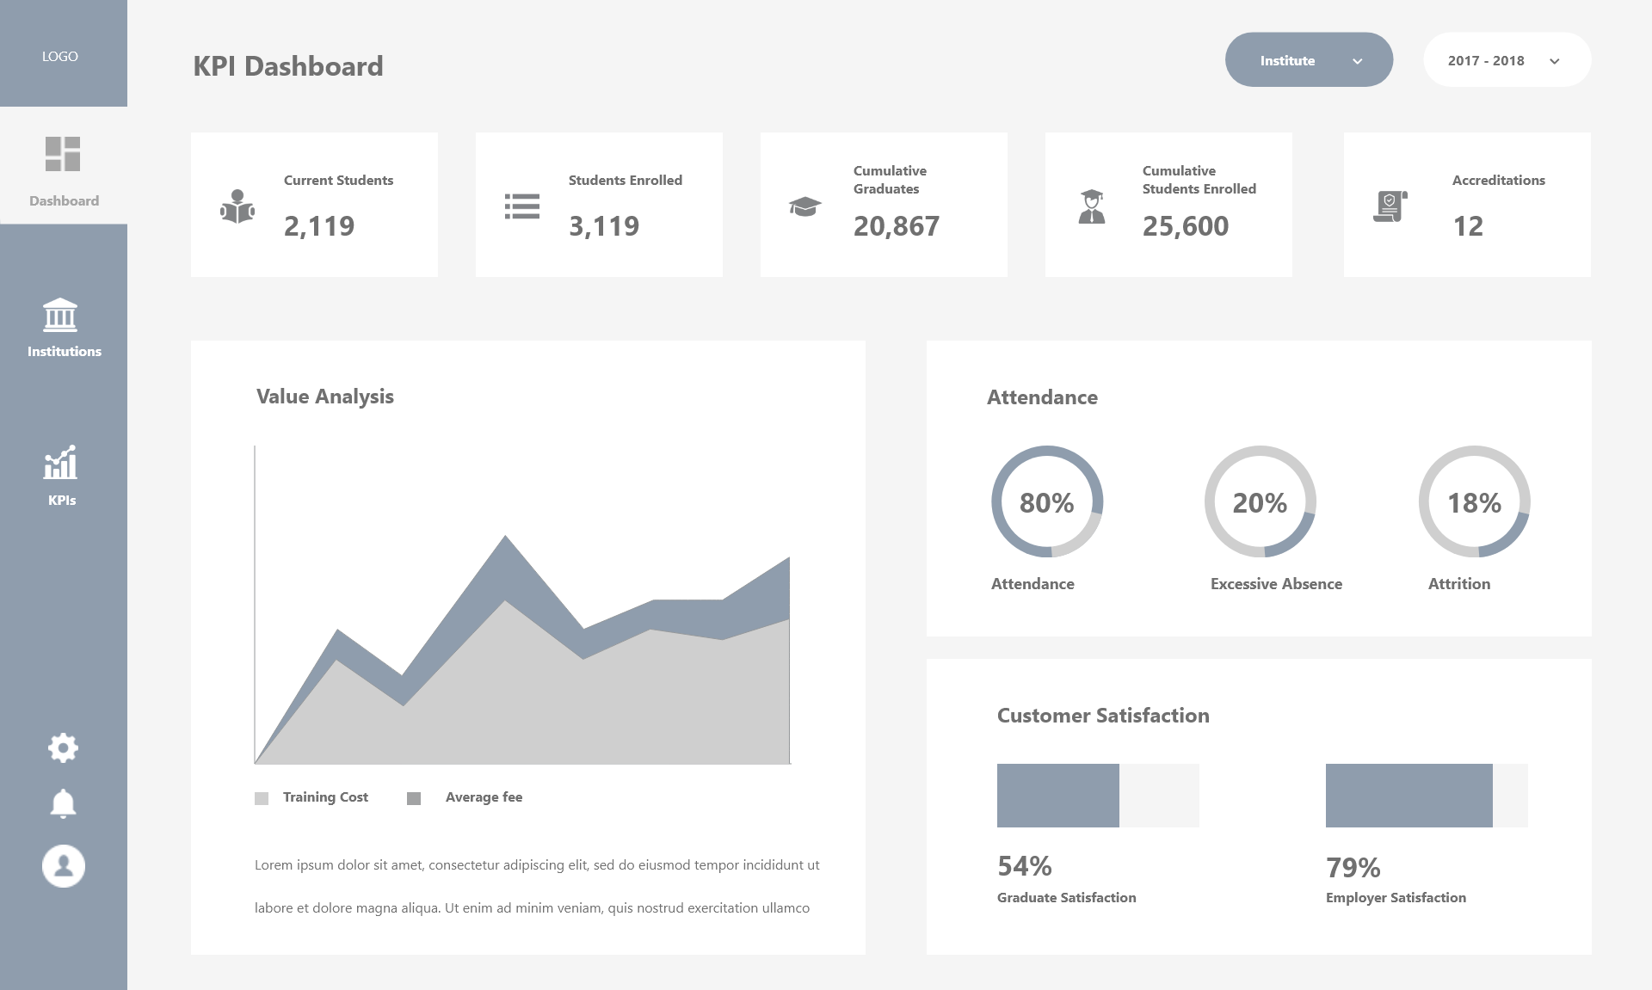
Wireframing - Page Layout
Source

Slide 11
Wireframing - Demo

Slide 12
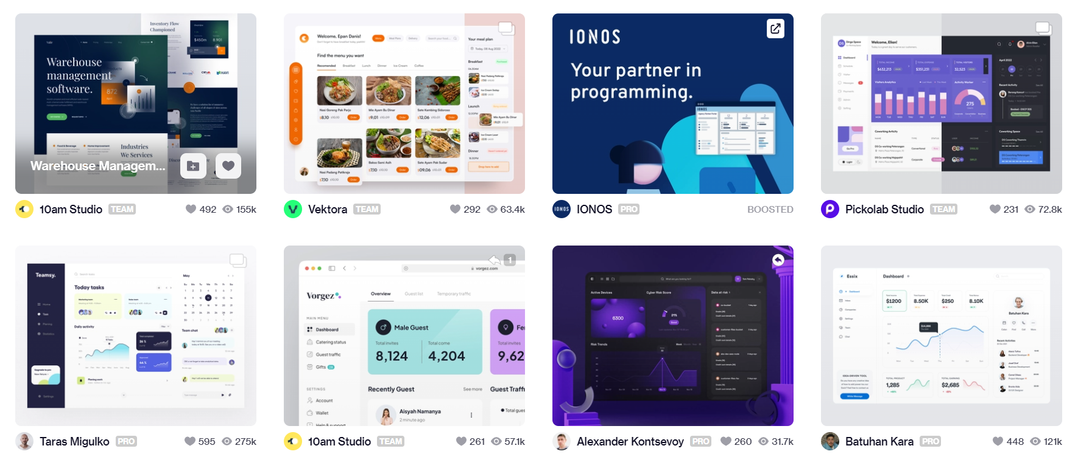
Taking Inspiration from AI
Sources: Dribbble, Behance

Slide 13
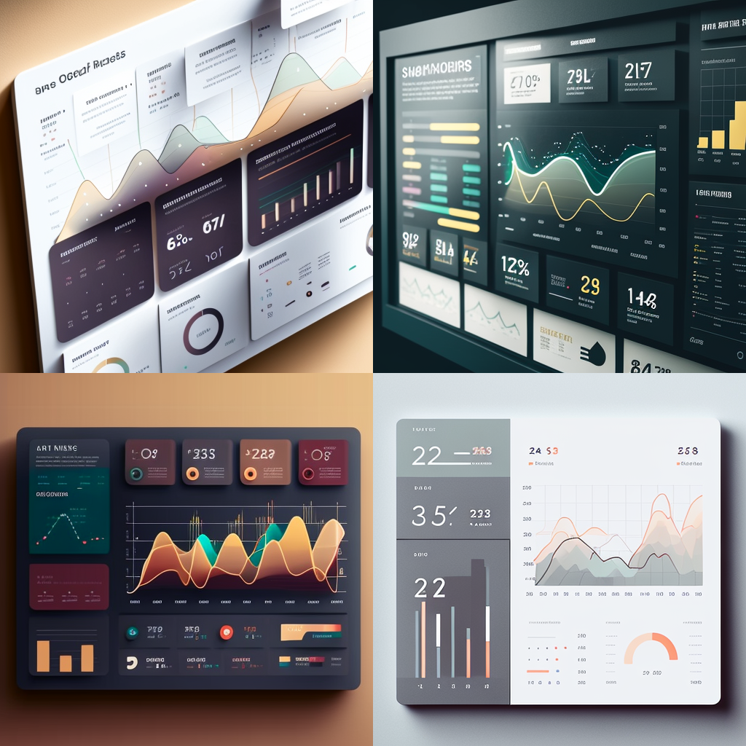
Taking Inspiration from AI
Prompt:
a dashboard design with cards showing numbers and a line chart showing trends, ui, ux, data --v4
Source

Slide 14
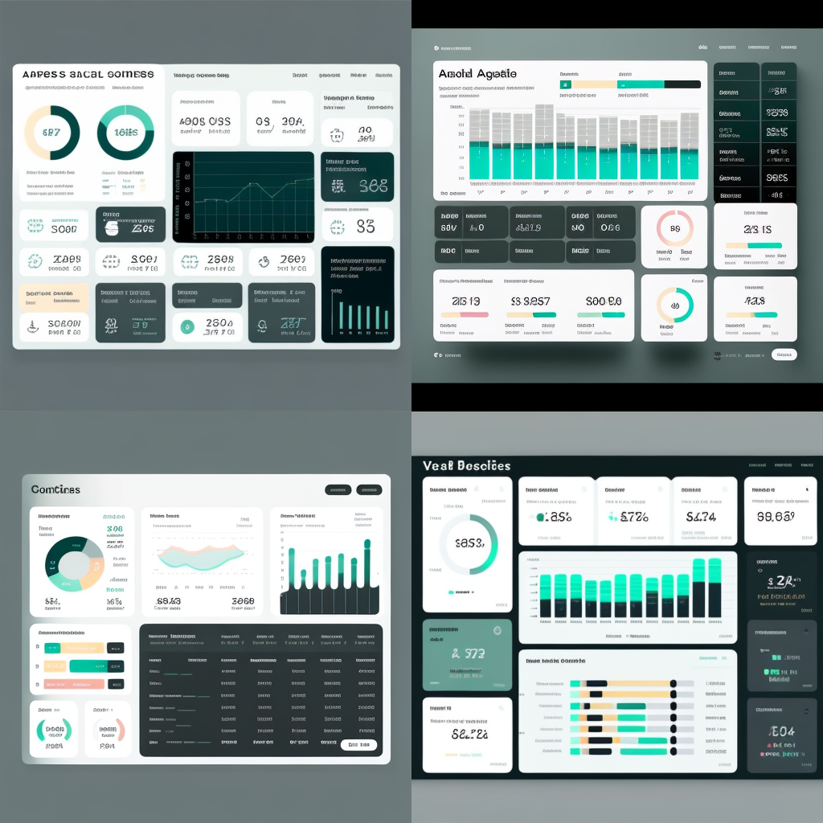
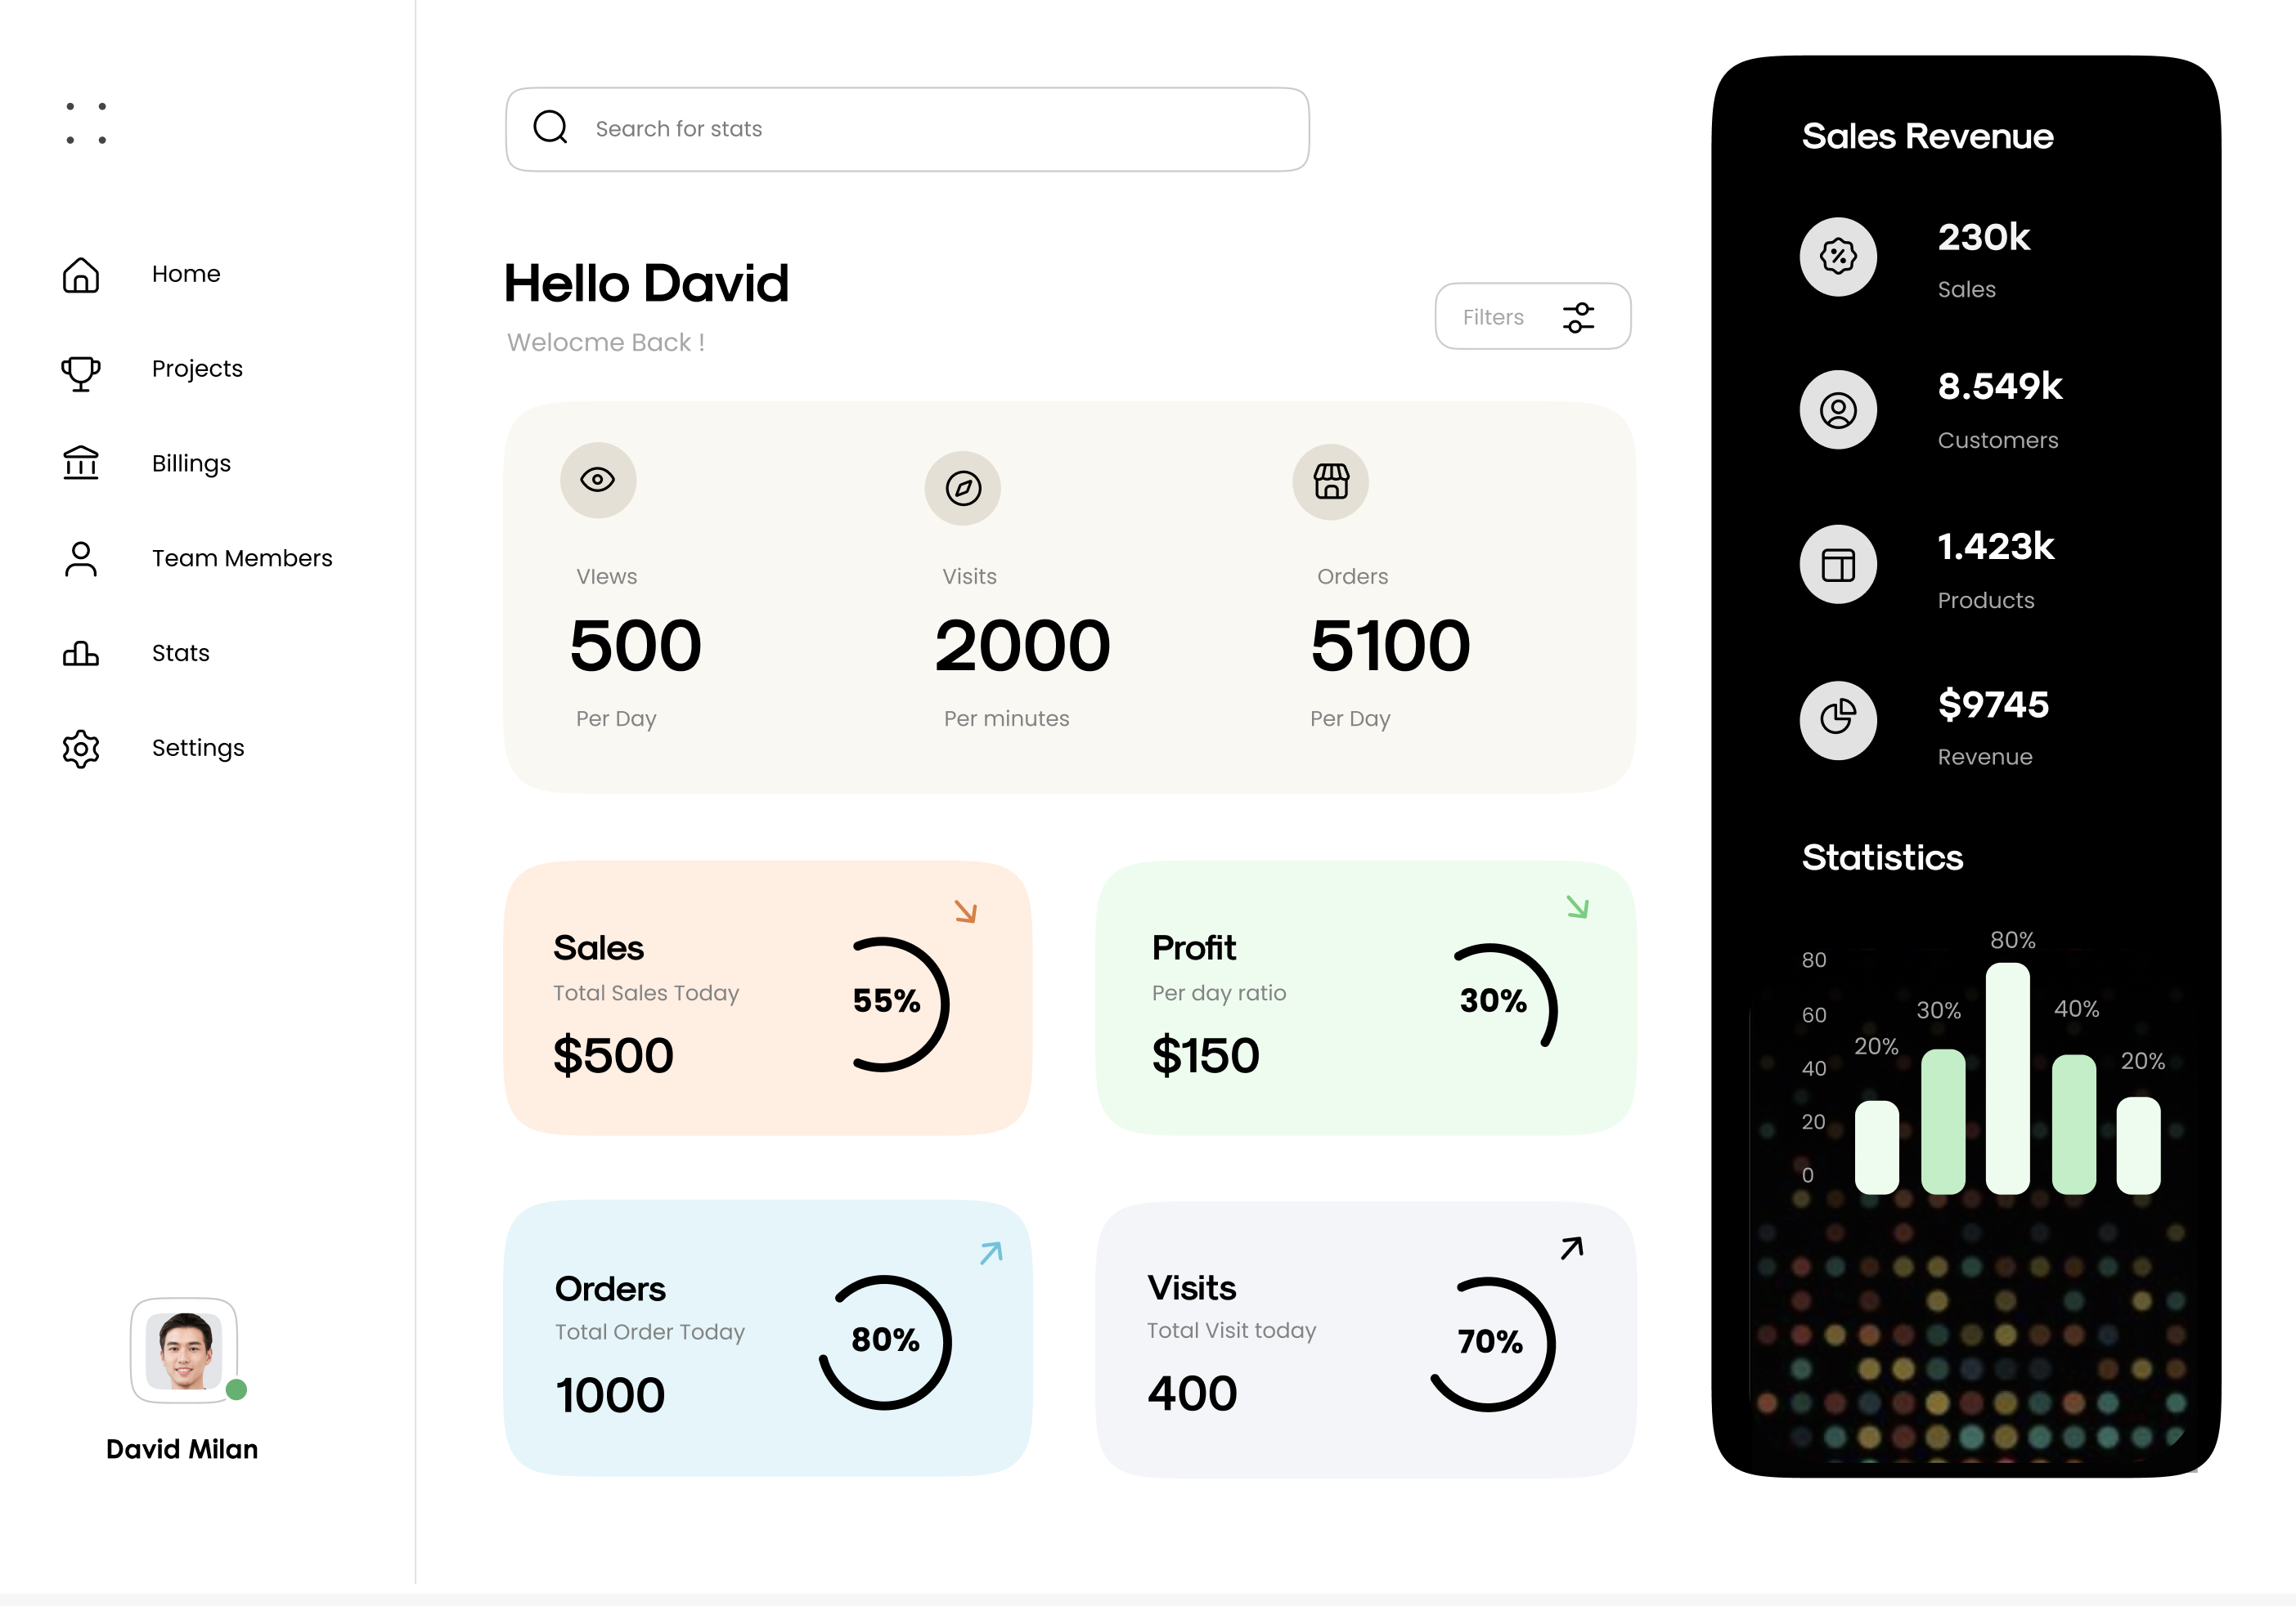
Taking Inspiration from AI
Prompt:
a dashboard design showing sales data for a software company including a company logo, teal, gray, navy, actuals, forecast, budget v4
Source
Source

Slide 15
2. Foundation

Slide 16
Page Structure
Grid
Spacing
Alignment
Icons sources: 1, 2, 3

Slide 17
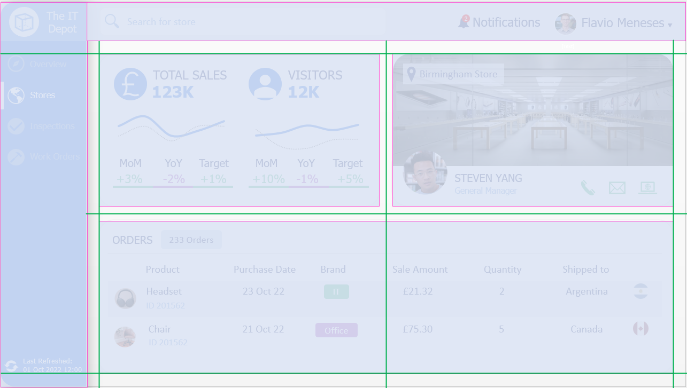
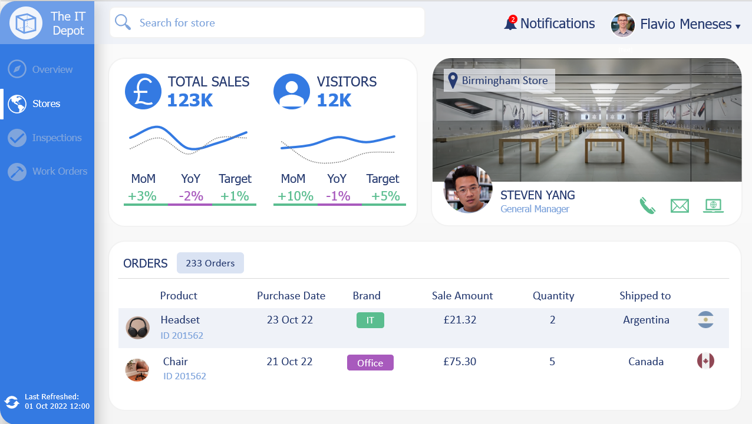
Page Structure - Grid

Slide 18
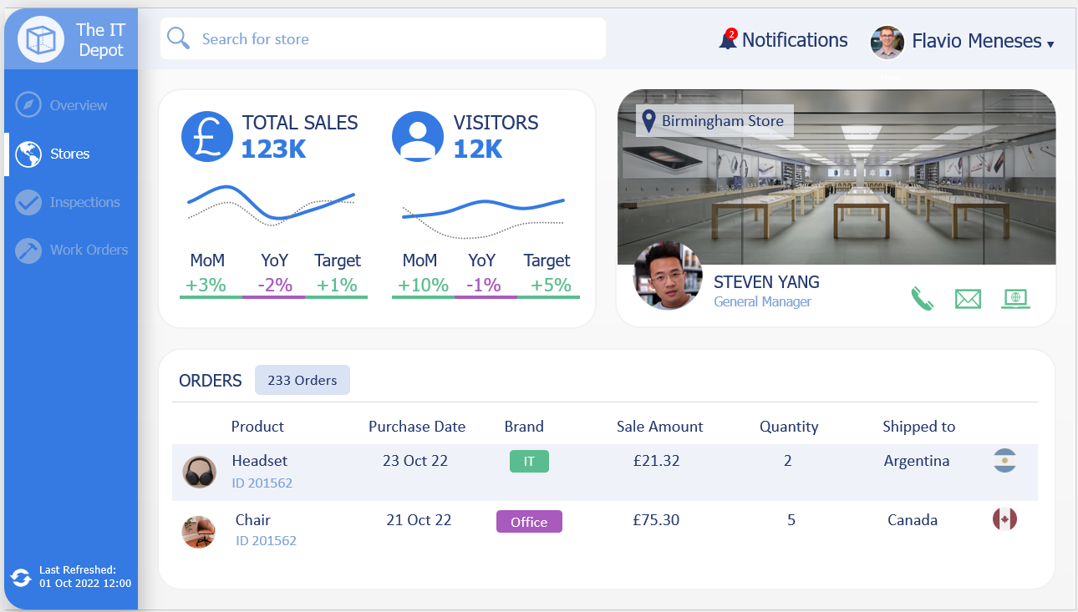
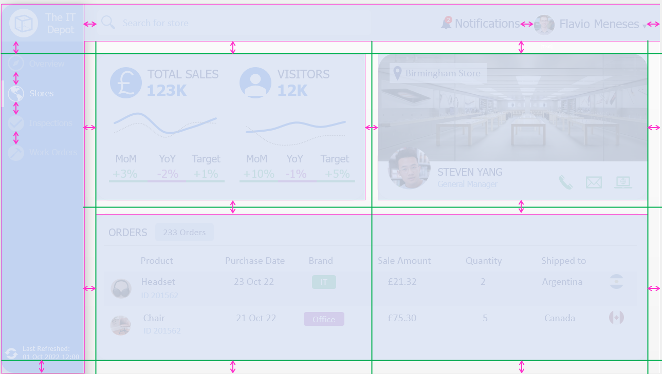
Page Structure - Spacing

Slide 19
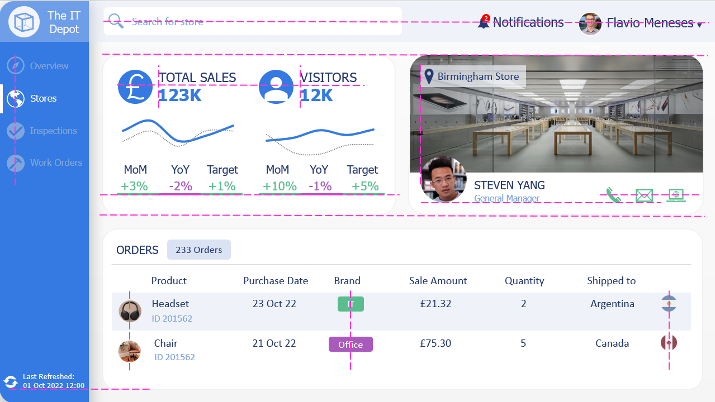
Page Structure - Alignment

Slide 20
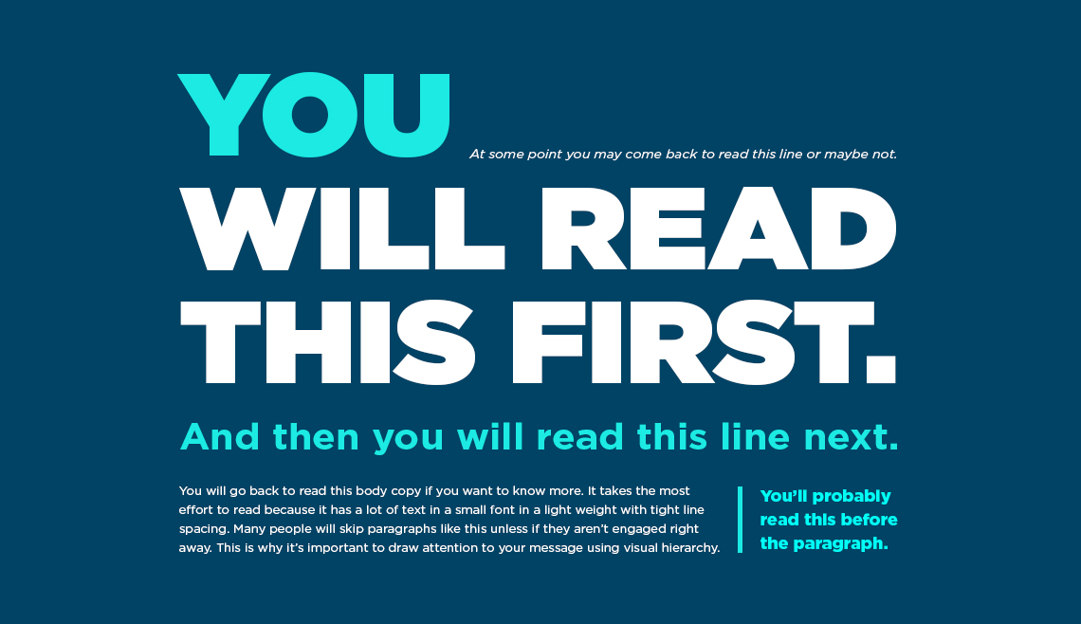
Visual Hierarchy
Source

Slide 21
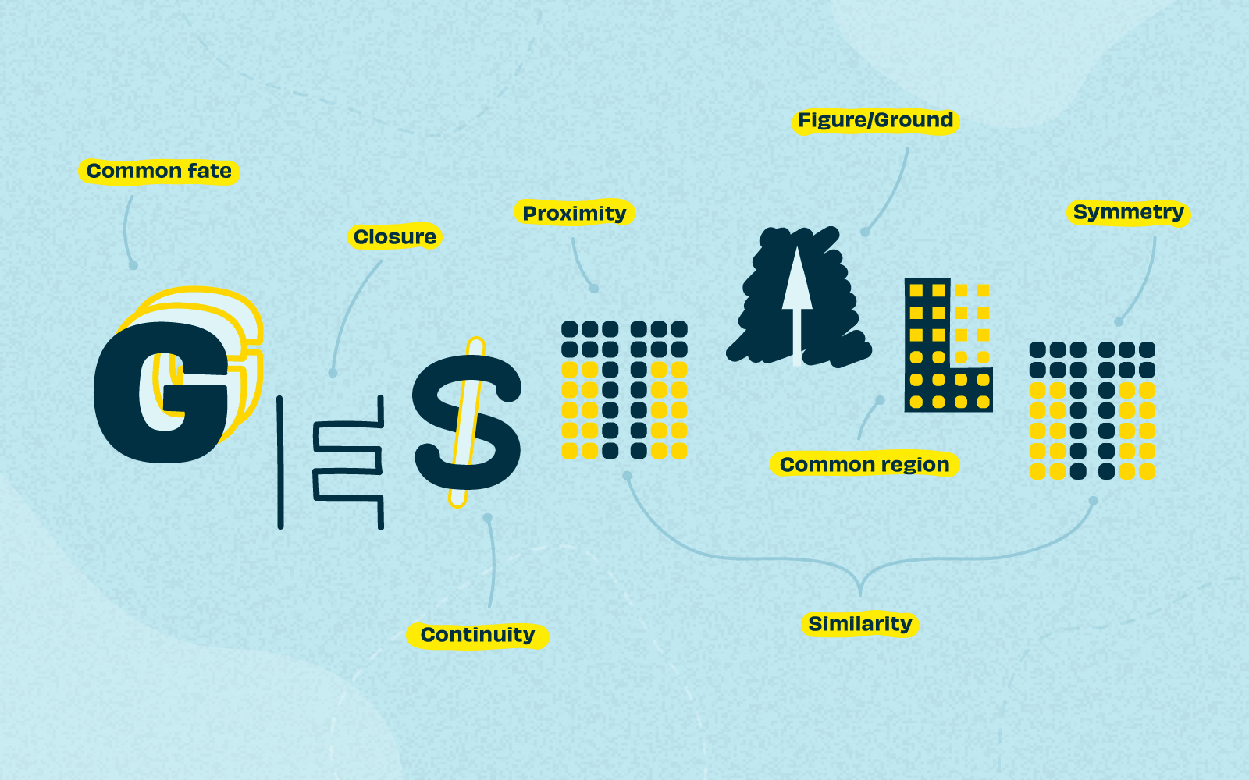
Visual Hierarchy - Gestalt Principles
Source
Notes:
The Gestalt Principles originated in Germany in the 1920’s. It states our brains perceive designs as a whole rather than individual elements. To do so it take shortcuts to simplify complexity by identifying patterns and filling in the blanks

Slide 22
Gestalt Principles – Figure/Ground
Source

Slide 23
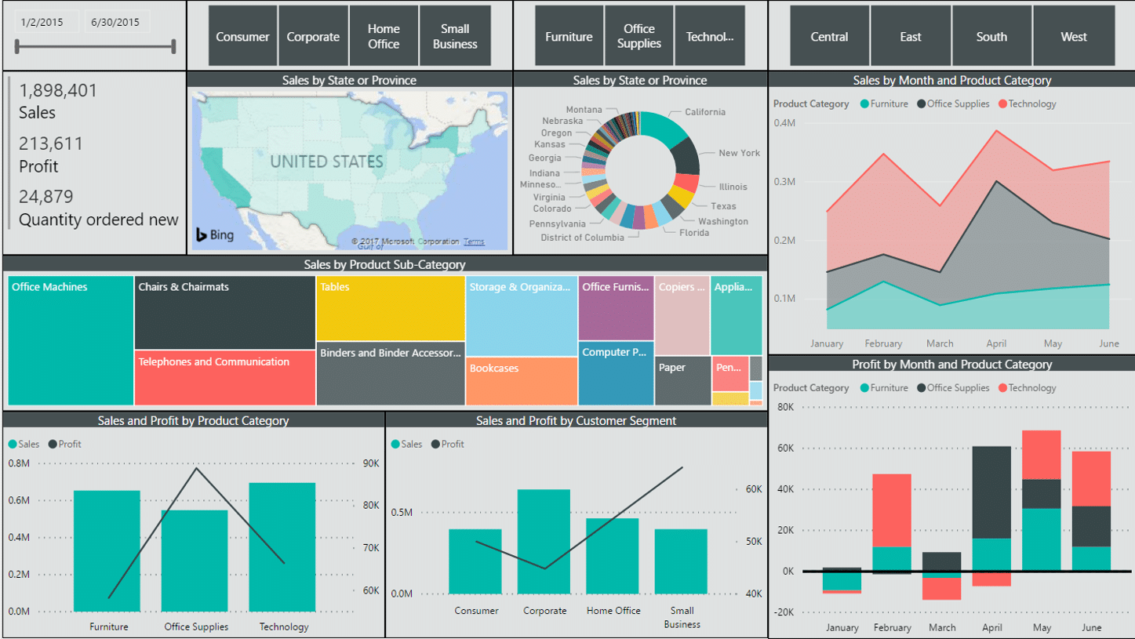
Lack of Visual Hierarchy
Source

Slide 24
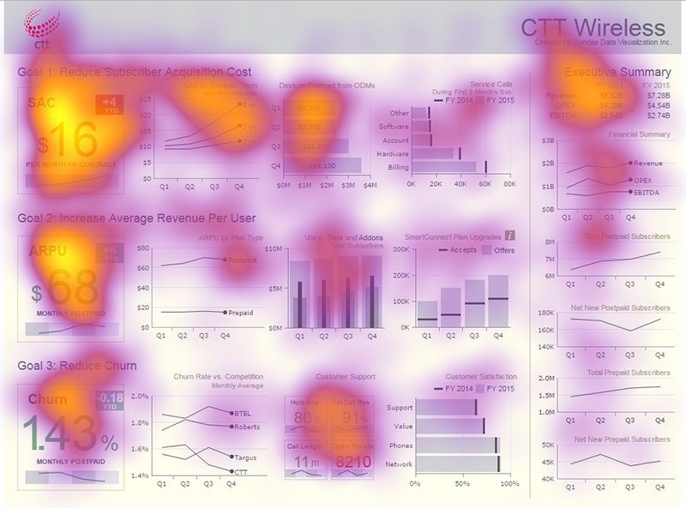
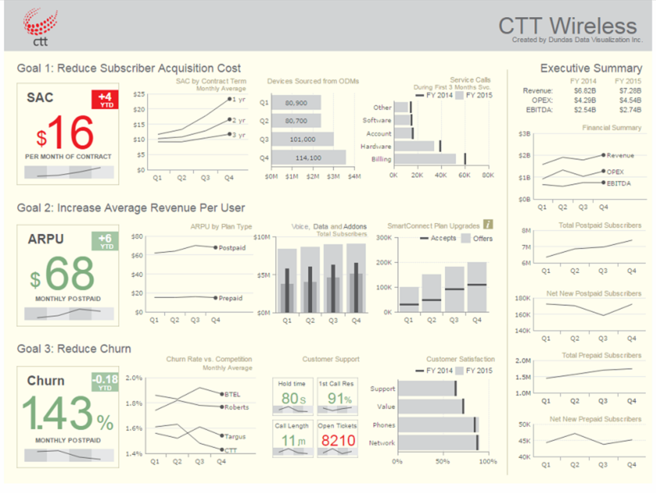
Visual Hierarchy - Arrangement
Source

Slide 25
Visual Hierarchy - Arrangement
Big numbers at the top:
Seen
3x
faster
Analysed
2.5x
longer
Source

Slide 26
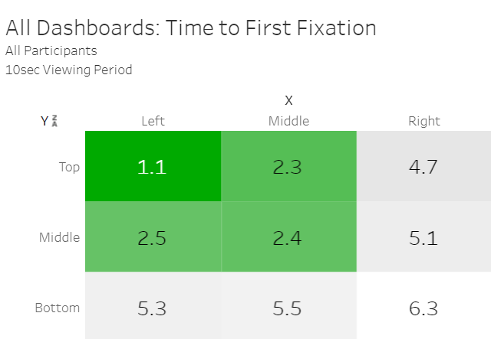
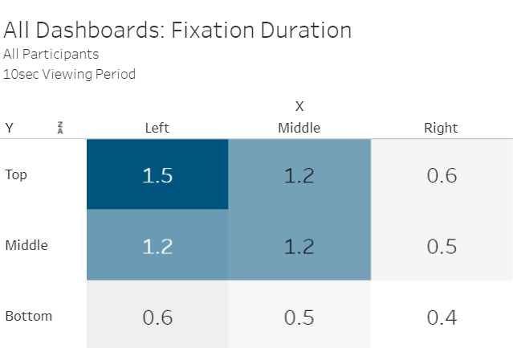
Arrangement of visuals
Top left of the page is important for user attention
Source:1,2

Slide 27
Arrangement of visuals
Larger font:
Seen
1.4x
faster
Analysed
2x
longer
BIGGER elements attract more
user attention
Source

Slide 28
Arrangement of visuals
Research caveats:
Unguided analysis for 10 seconds
150 participants
Report design influences results
Top/left focus predominant in western culture

Slide 29
3. Finishes

Slide 30
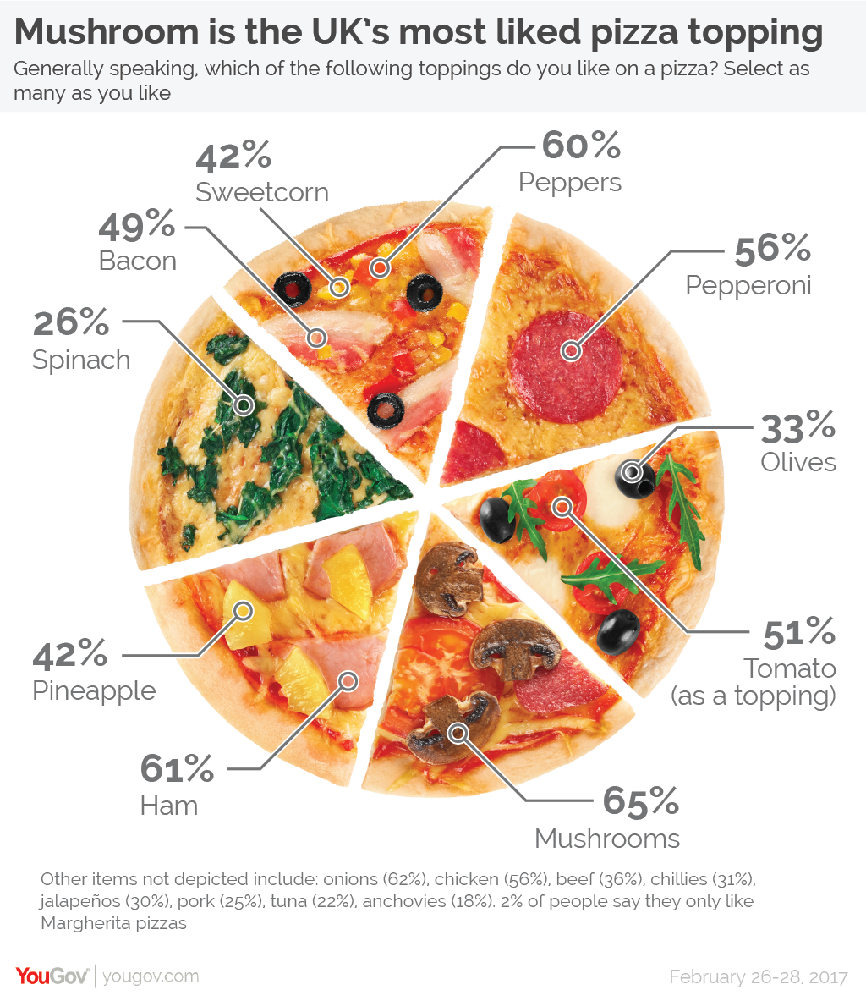
Pick the right visual
Source

Slide 31
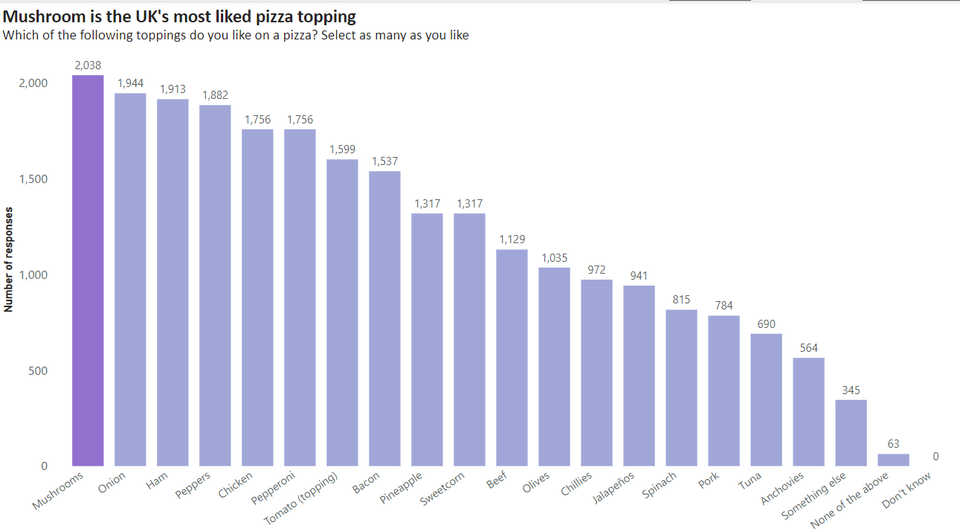
Pick the right visual

Slide 32
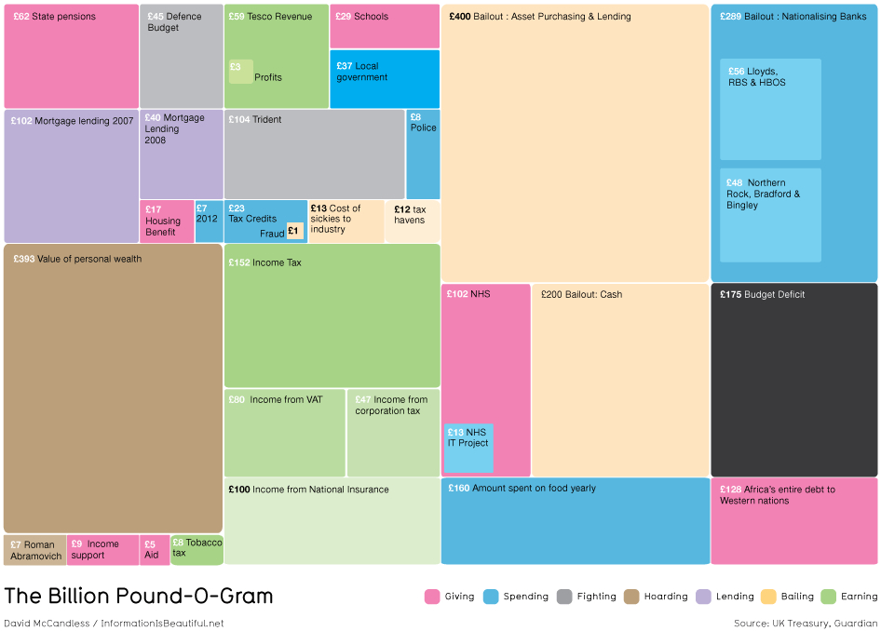
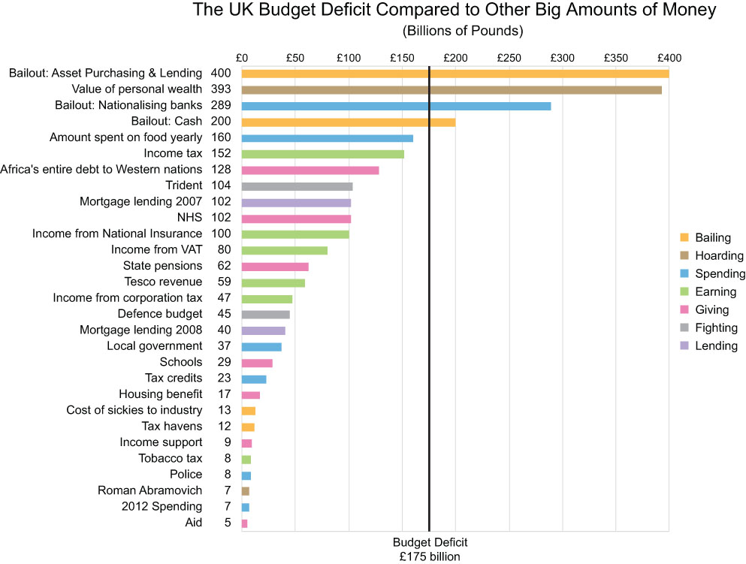
Pick the right visual
Source
Notes:
The following chart was created for the Guardian to help readers understand the size of the British budget deficit (the black rectangle) by comparing it to other large sums of money that are familiar.

Slide 33
Pick the right visual – online tool
Source

Slide 34
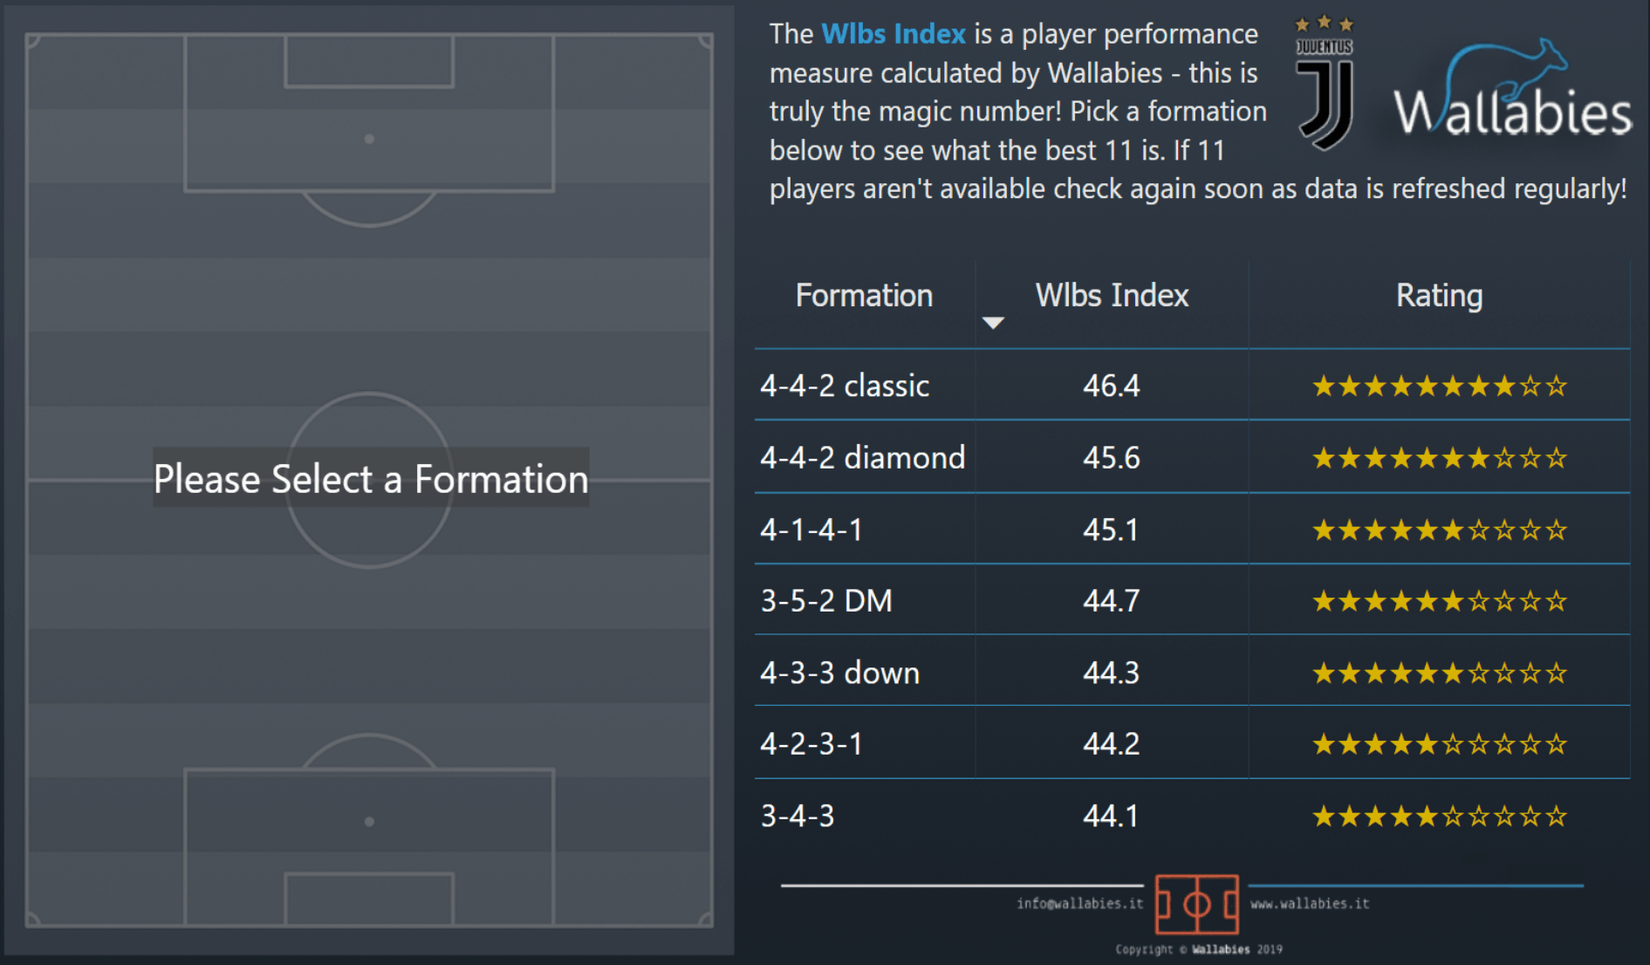
Advanced visuals - presentation
Source

Slide 35
Advanced visuals – video series
Source

Slide 36
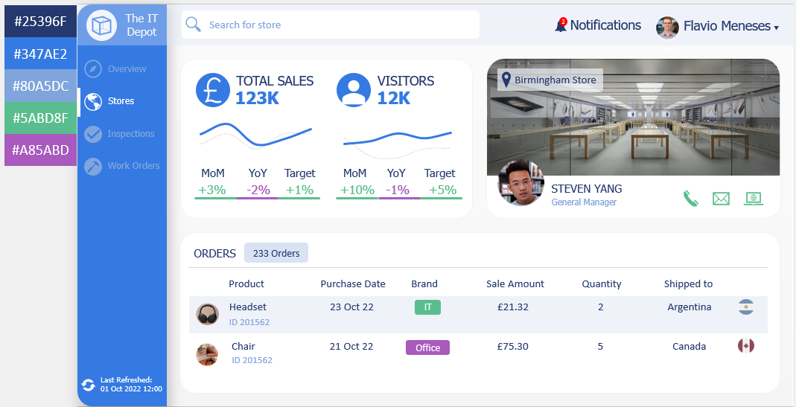
Colour

Slide 37
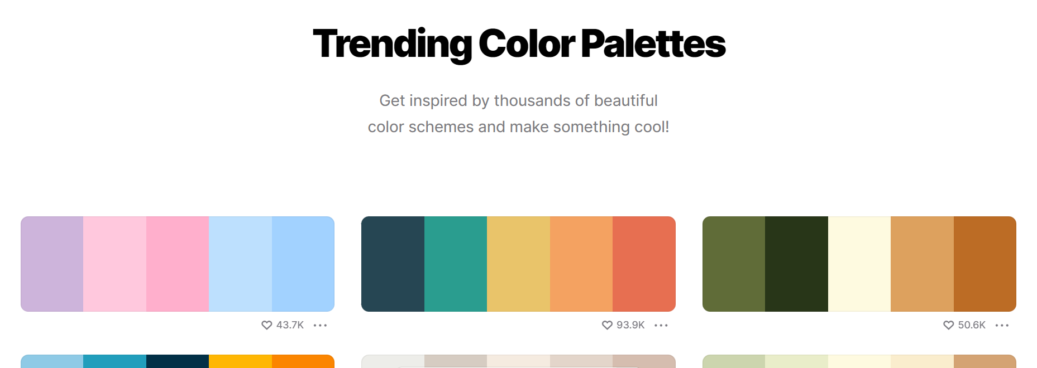
Colour
Source

Slide 38
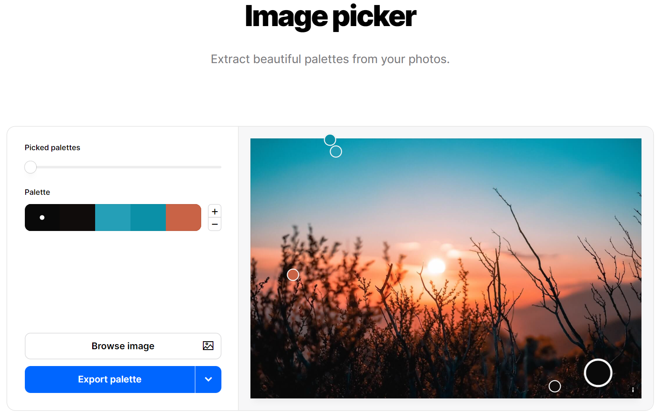
Colour
Source

Slide 39
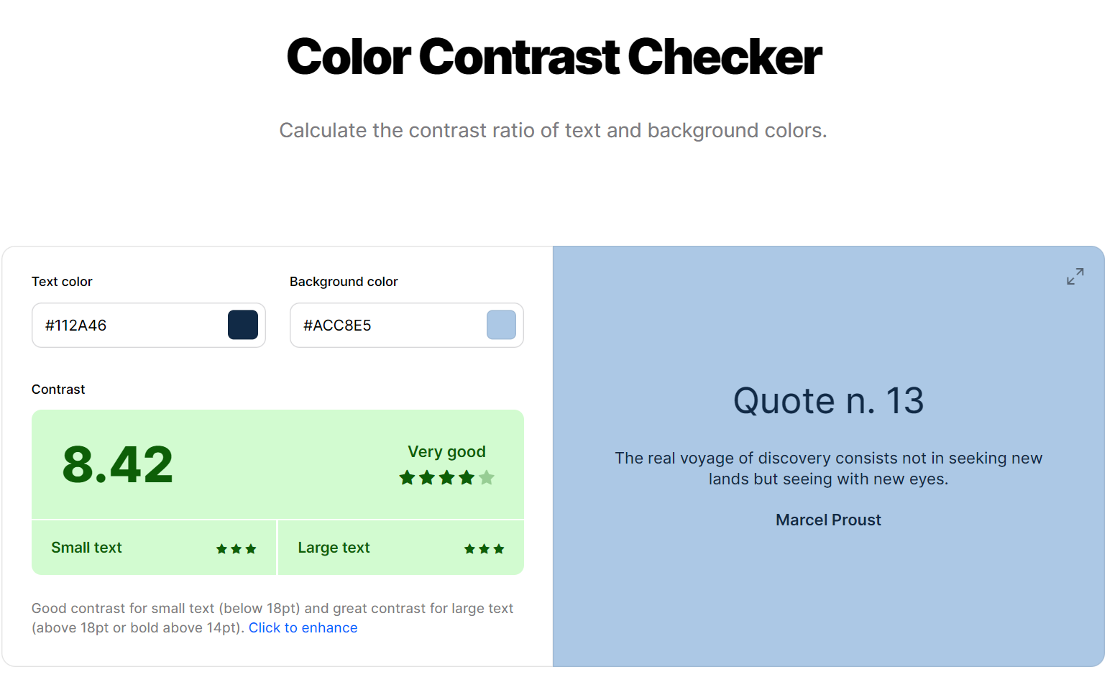
Colour
Source

Slide 40
Accessibility
At least 1 in 5 people in the UK have a long-term illness, impairment or disability
The accessibility regulations came into force for public sector in September 2018
Failure to comply means breach of the Equality Act 2010 and the Disability Discrimination Act 1995
Same exceptions to the regulations apply
Source

Slide 41
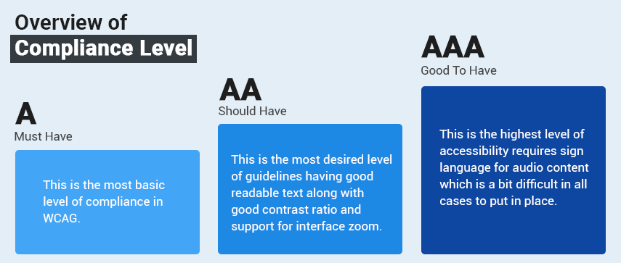
Accessibility - Requirements
Publish an accessibility statement that explains how accessible your website or mobile app is
Meet the Web Content Accessibility Guidelines 2.1 - Level AA
Source: 1,2

Slide 42
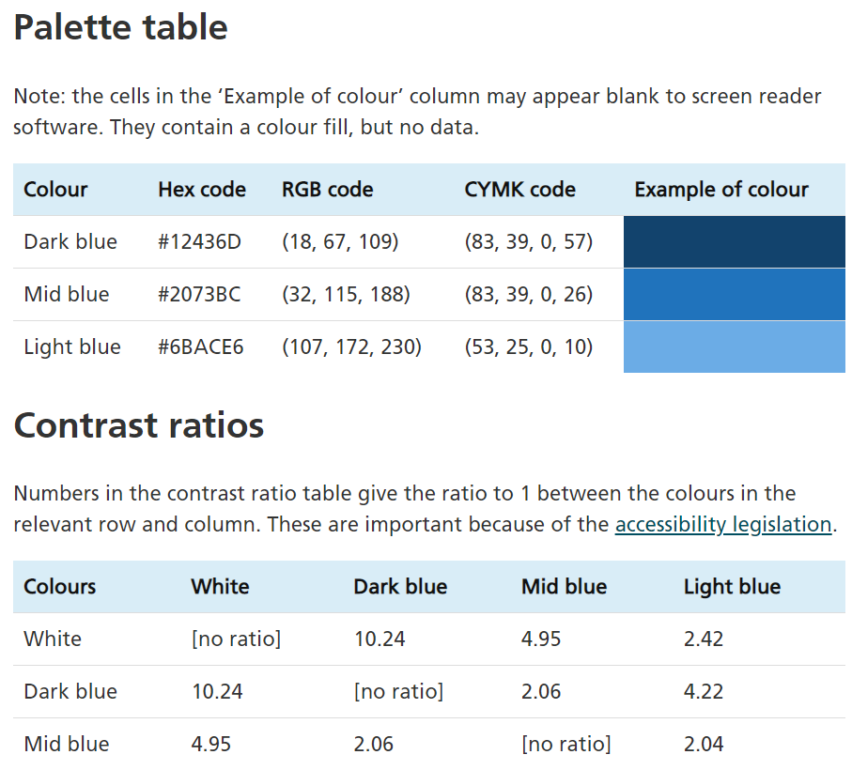
Accessibility - Guidance
Government Analysis Function has useful guidelines applicable to data visualisation:
Charts
Colours

Slide 43
Accessibility - Example
Source

Slide 44
Accessibility - Example

Slide 45
Thanks!
You can find me at:
Flavio Meneses
Feedback:
Presentation template by SlidesCarnival

Slide 46
Sponsors – Thank you
We couldn’t do it without you.

