Slide 2
Intro
I’m Flavio Meneses, originally from Portugal and living in the UK since 2014;
Microsoft Certified Data Analyst Associate;
Managing Consultant & BI Developer at LogiKal Projects.

Slide 3
Agenda
1
Data visualisation principles
2
Python and R
3
SVG
4
Deneb
5
Charticulator
6
Power BI visuals SDK

Slide 4
Data visualisation principles
1

Slide 5
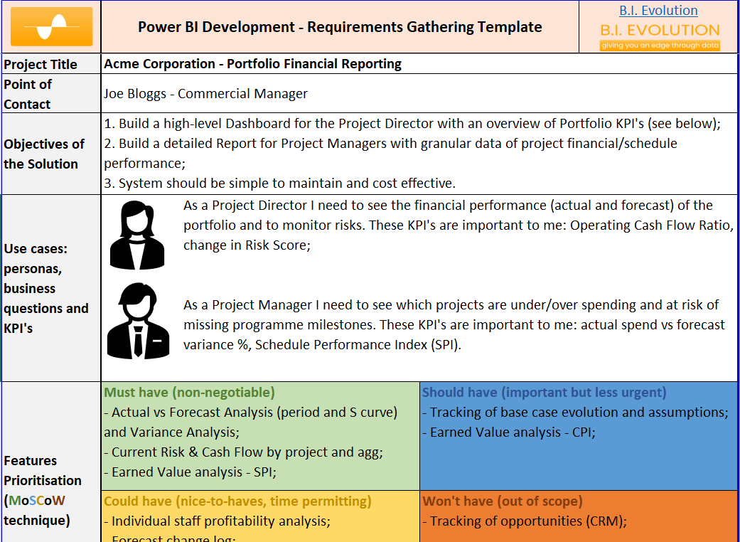
Data visualisation principles
1. Gather requirements
Source

Slide 6
Data visualisation principles
2. Wireframe
Source

Slide 7
Data visualisation principles
3. Stick to the basics
Source

Slide 8
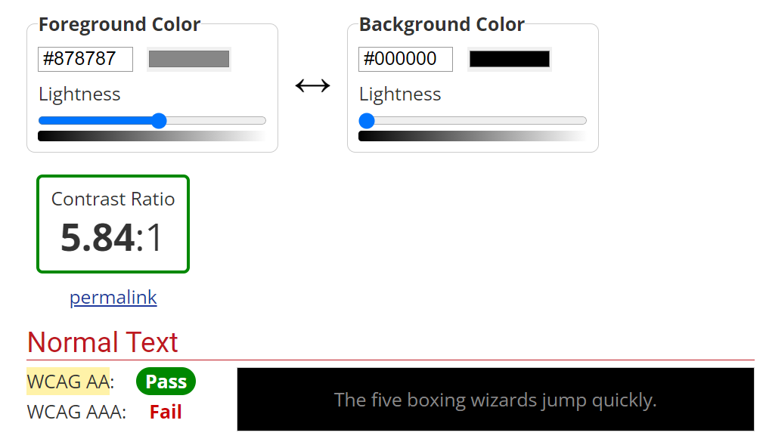
Data visualisation principles
4. Remember accessibility
Source

Slide 9
Data visualisation principles
5. Pick the right tool for the job
Source

Slide 10
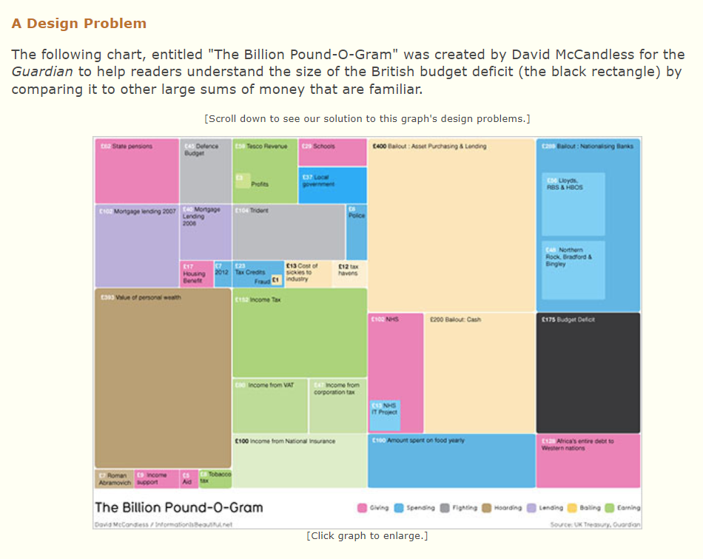
Data visualisation principles
A case study
Source

Slide 11
Python and R
2

Slide 12
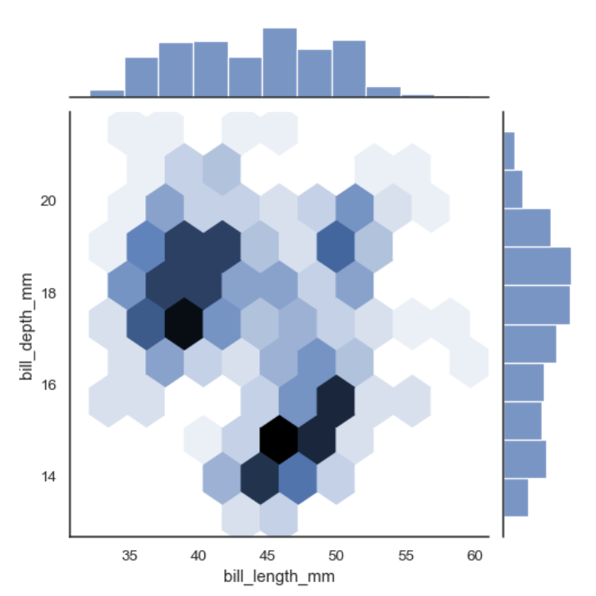
Python and R scripts
1. Installation guide from MS here;
2. Example from the Python “Seaborn” package. Source
3. Beware of limitations. Needs paid licensing for publishing; can’t publish to web.
Notes:
import numpy as np
import seaborn as sns
import matplotlib.pyplot as plt
sns.set_theme(style="ticks") rs = np.random.RandomState(11)
x = rs.gamma(2, size=1000)
y = -.5 * x + rs.normal(size=1000) sns.jointplot(x=x, y=y, kind="hex", color="#4CB391") plt.show()

Slide 13
SVG
3

Slide 14
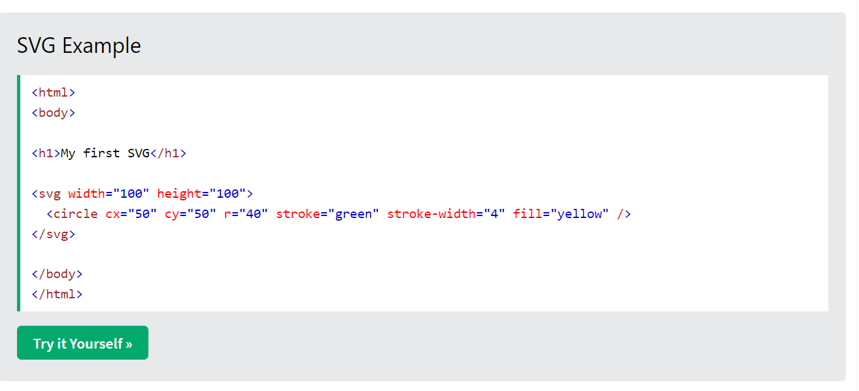
SVG
SVG 101
Source

Slide 15
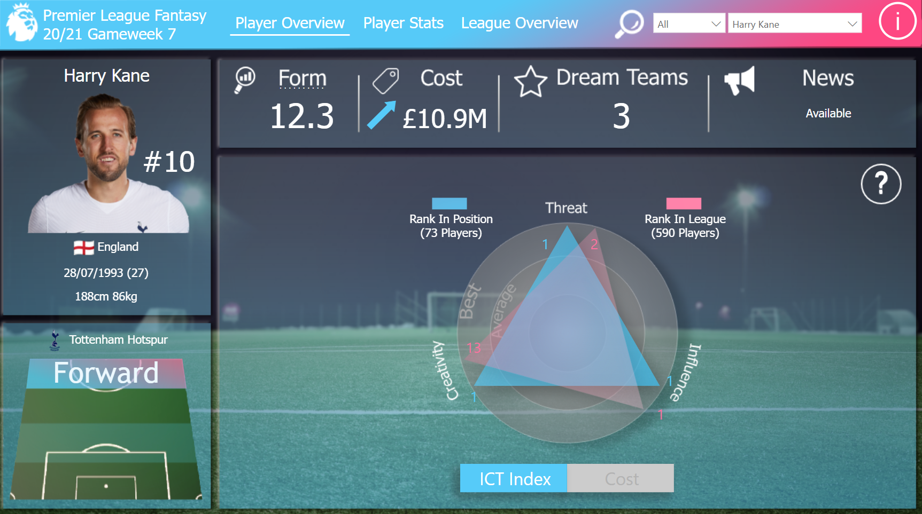
SVG
A case study
Source

Slide 16
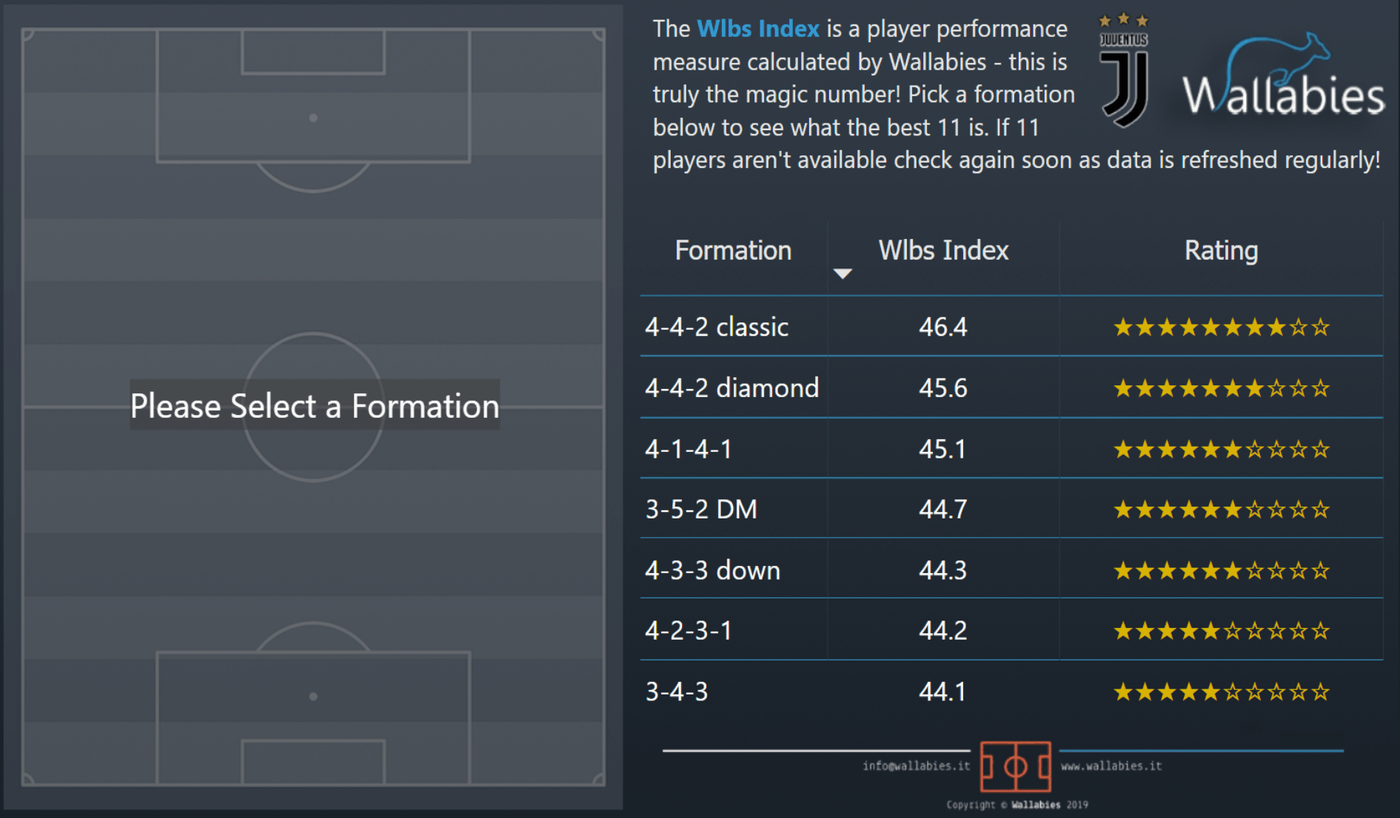
SVG
A case study
Source

Slide 17
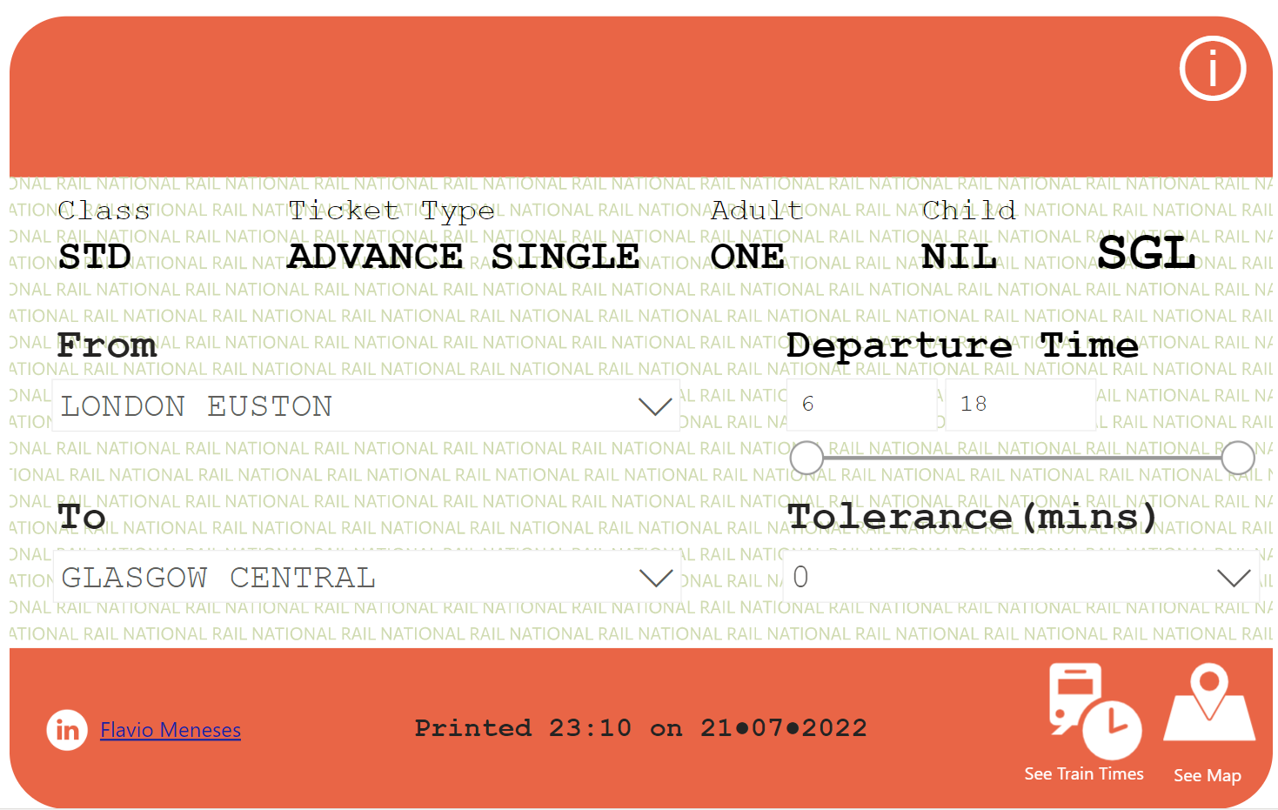
SVG
A case study
Source

Slide 18
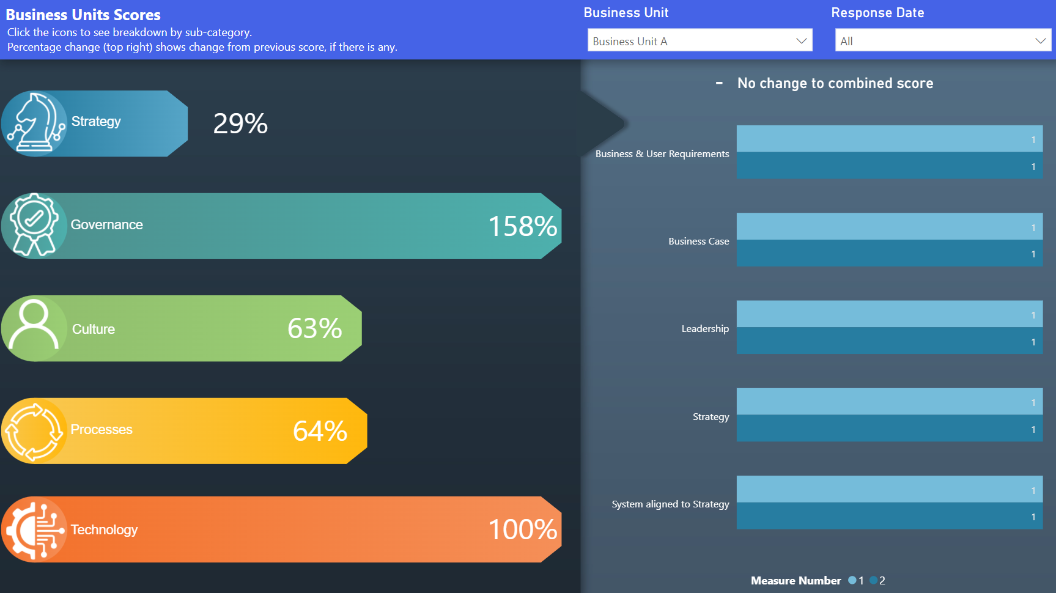
SVG
A case study
Source

Slide 19
Deneb
4

Slide 20
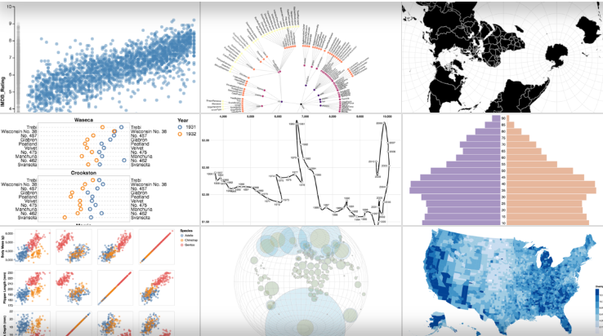
Deneb
Based on Vega & Vega-Lite visualization grammar
Source

Slide 21
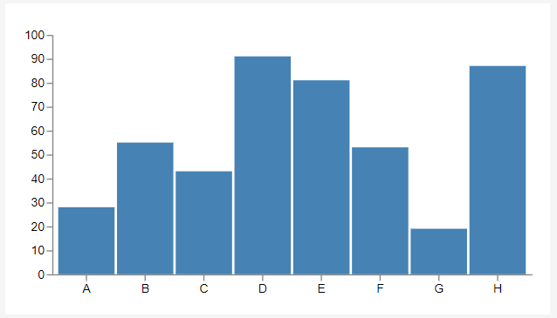
Deneb
Vega & Vega-Lite 101
Source

Slide 22
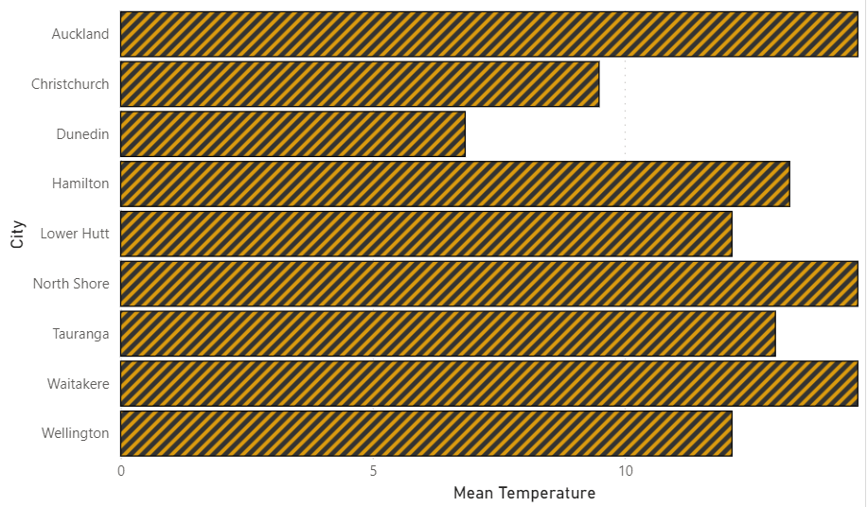
Deneb
Deneb for Power BI

Slide 23
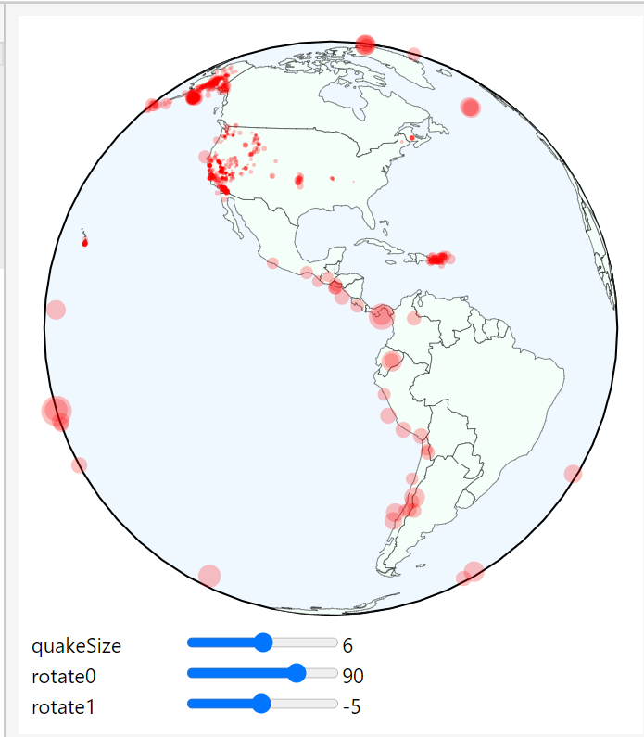
Deneb
Maps with Deneb
Source

Slide 24
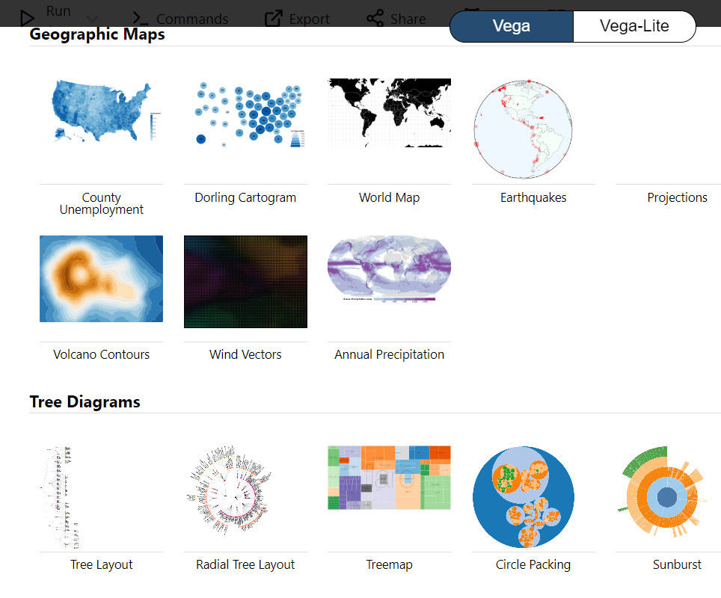
Deneb
Examples library
Source

Slide 25
MS Charticulator
5

Slide 26
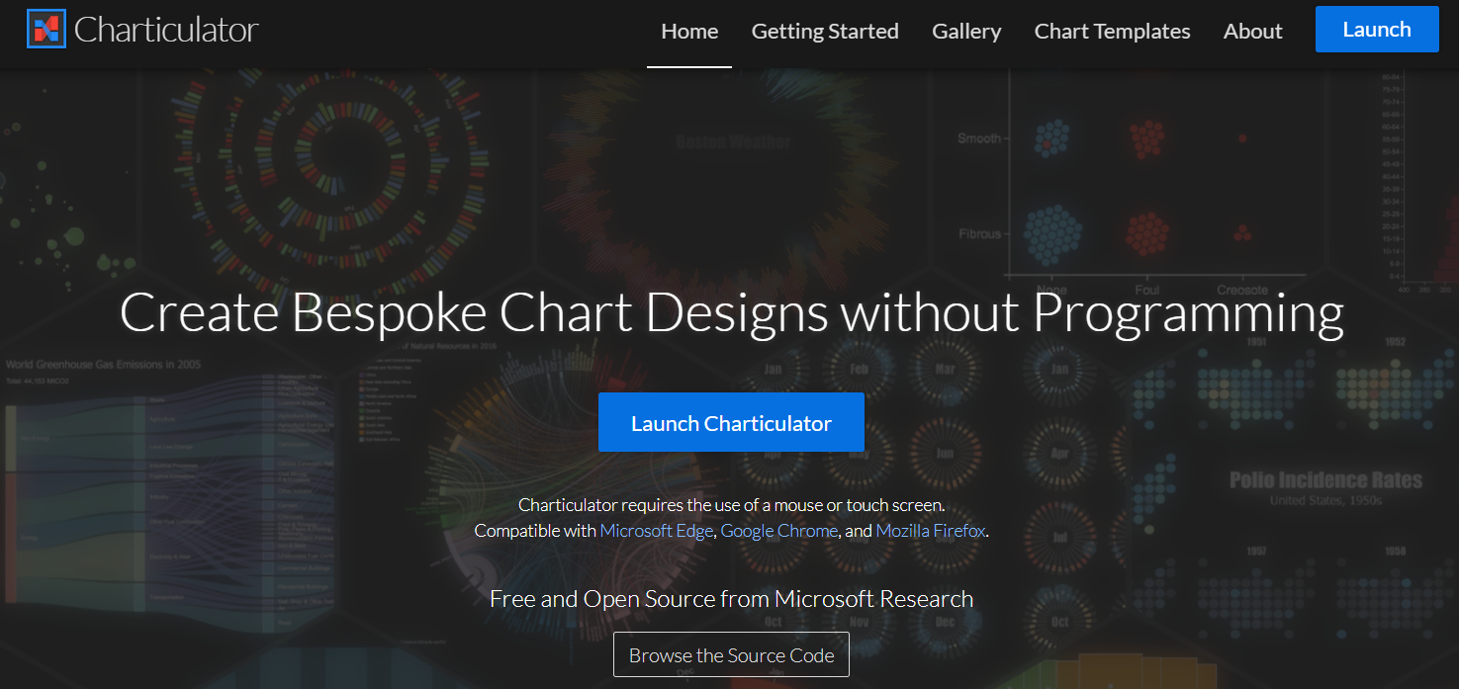
MS Charticulator
MS Charticulator
101
Source

Slide 27
Power BI visuals SDK
6

Slide 28
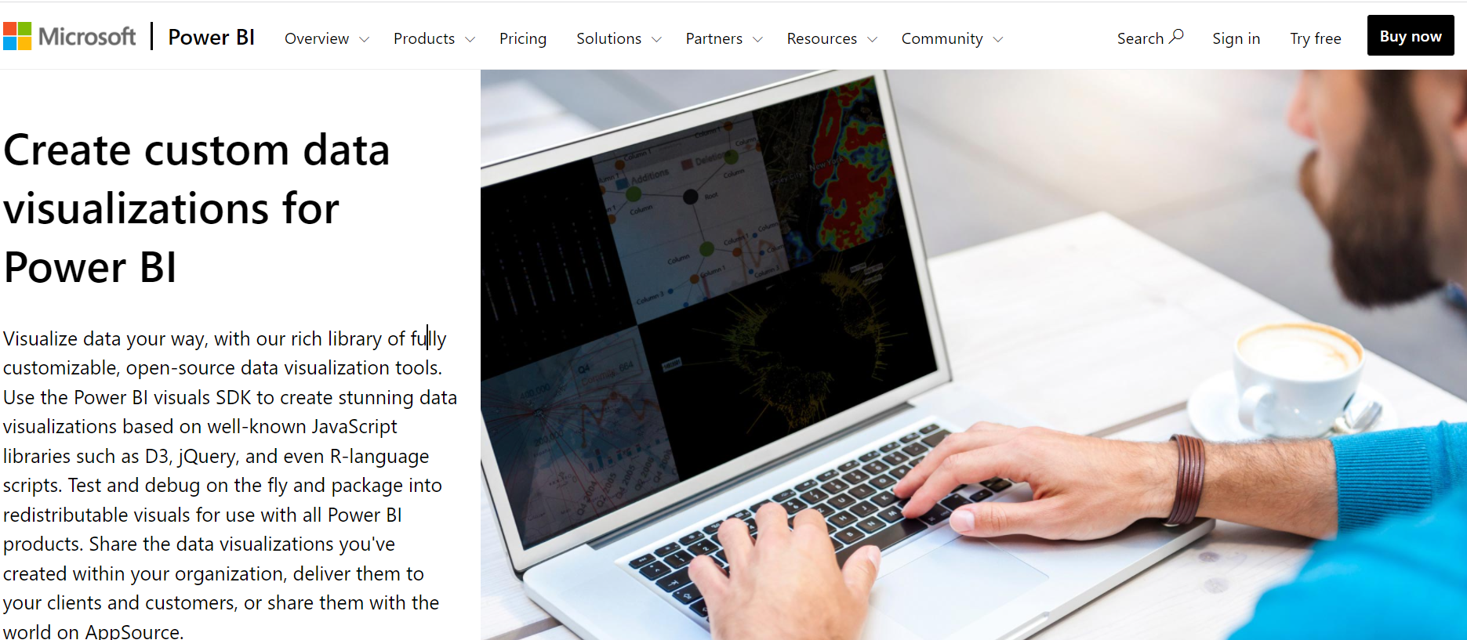
Power BI visuals SDK
Software Development Toolkit
Source

Slide 29
Thanks!
Any questions ?
You can find me at:
Flavio Meneses
fmeneses@logikalprojects.com
Presentation template by SlidesCarnival

