Slide 1
Power BI Advanced Visuals
Flavio Meneses
West Midlands Power BI User Group
25th Nov 2021

Slide 2
Intro
I’m Flavio Meneses, originally from Portugal but have been living in Birmingham, UK since 2014;
BI Analyst for the engineering company Arup; I also write about Power BI on my blog: https://bievolution.co.uk/
Microsoft Certified Data Analyst Associate.

Slide 3
Agenda
1
Data visualisation principles
2
Python and R scripts
3
Charticulator
4
SVG elements
5
Power BI visuals SDK

Slide 4
Data visualisation principles
1

Slide 5
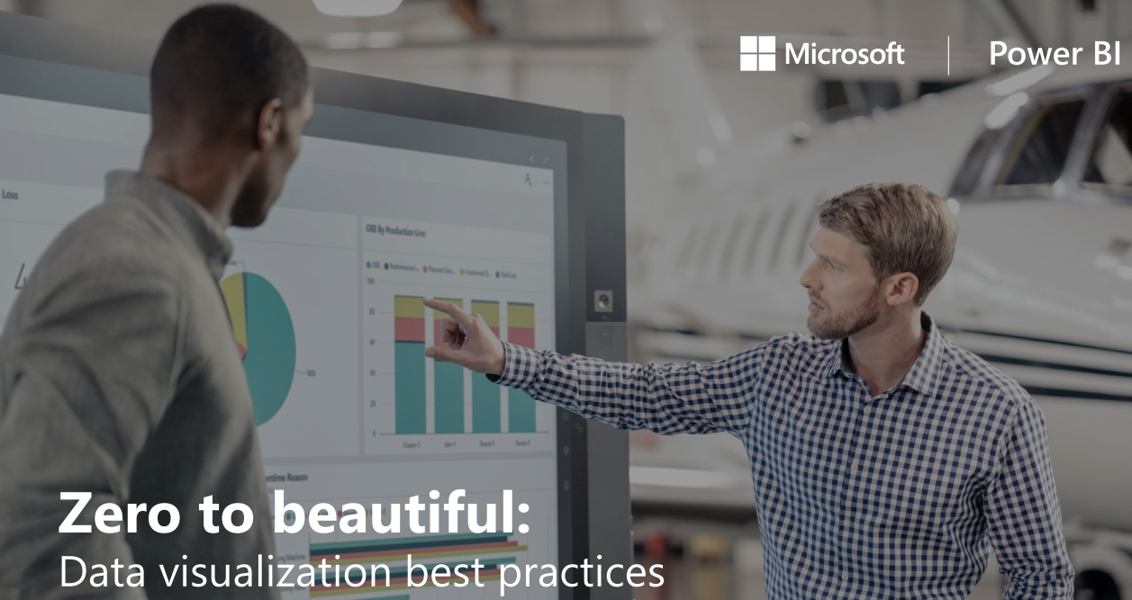
Data visualisation principles
Source

Slide 6
Data visualisation principles
Source

Slide 7
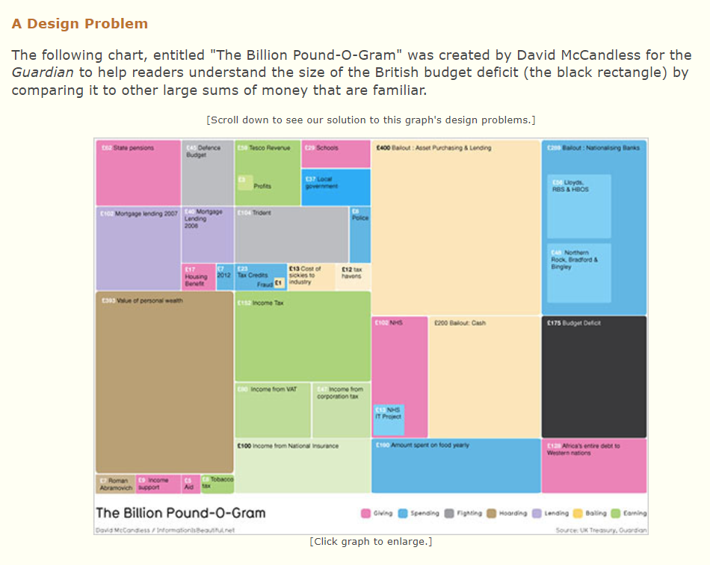
Data visualisation principles
Source

Slide 8
Python and R scripts
2

Slide 9
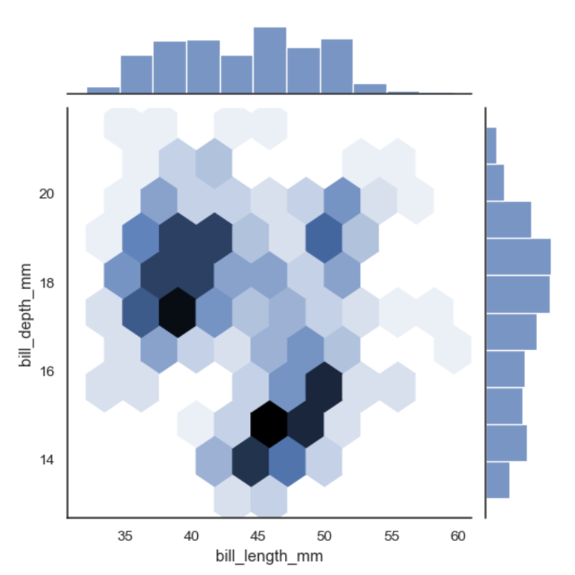
Python and R scripts
1. Installation guides from MS here;
2. Example from the Python “Seaborn” package. Source
Notes:
import numpy as np
import seaborn as sns
import matplotlib.pyplot as plt
sns.set_theme(style="ticks") rs = np.random.RandomState(11)
x = rs.gamma(2, size=1000)
y = -.5 * x + rs.normal(size=1000) sns.jointplot(x=x, y=y, kind="hex", color="#4CB391") plt.show()

Slide 10
Charticulator
3

Slide 11
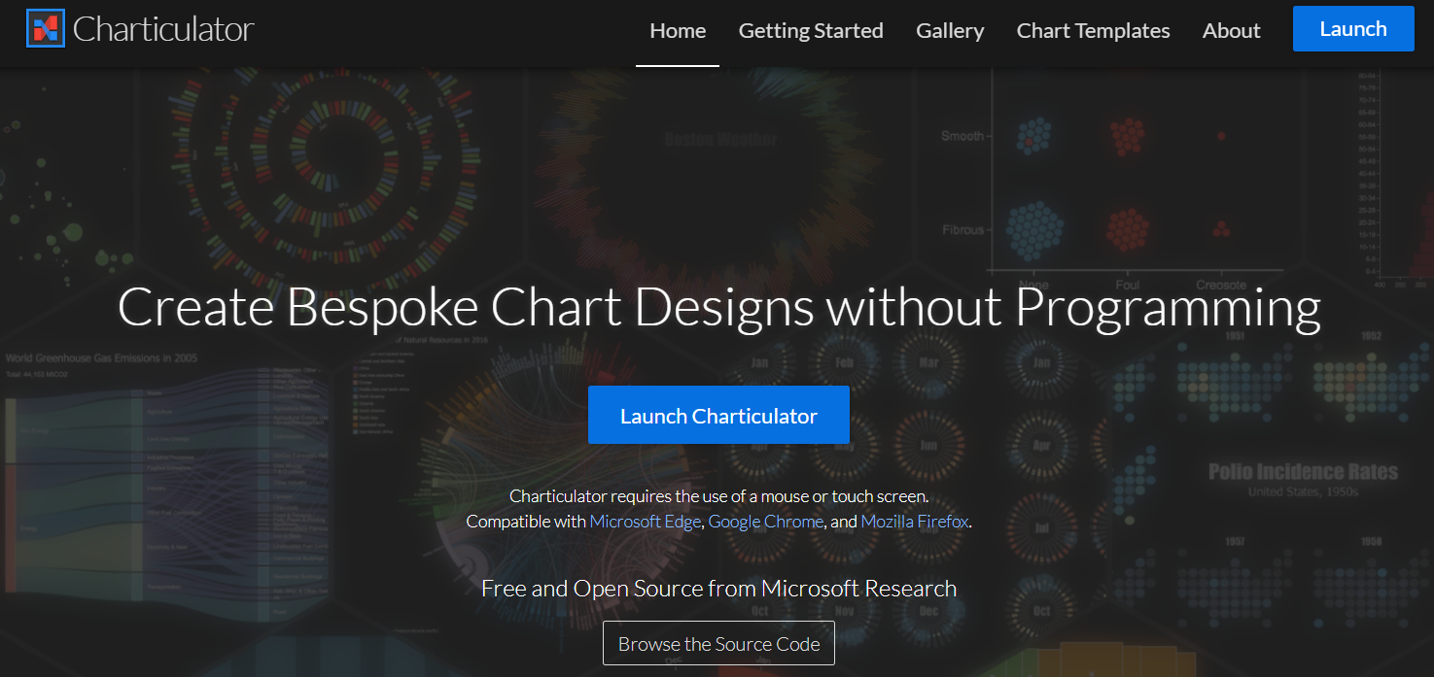
Charticulator
Source

Slide 12
SVG elements
4

Slide 13
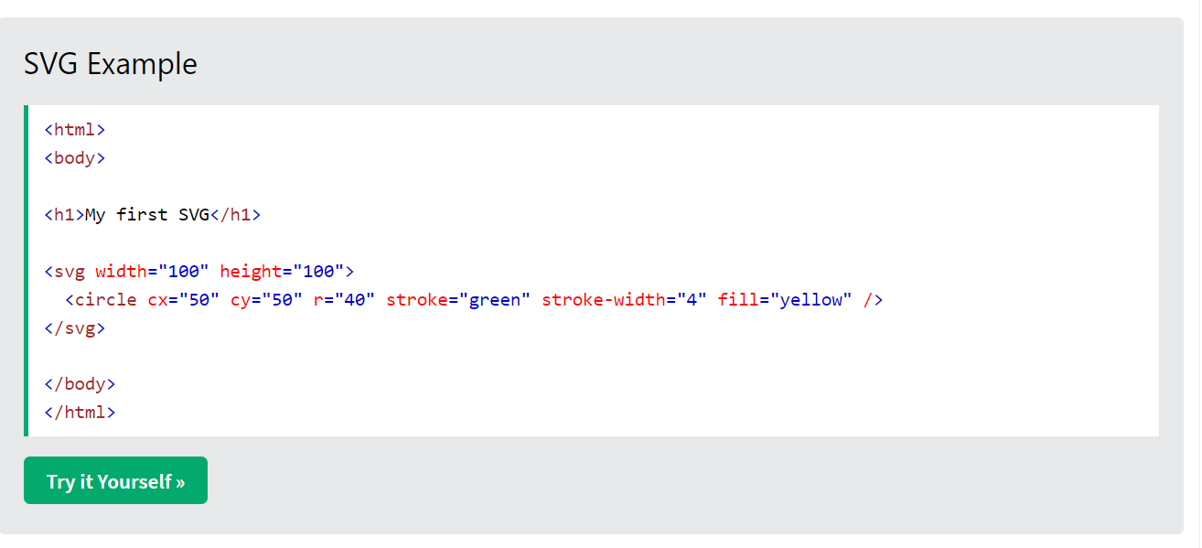
SVG elements
Source

Slide 14
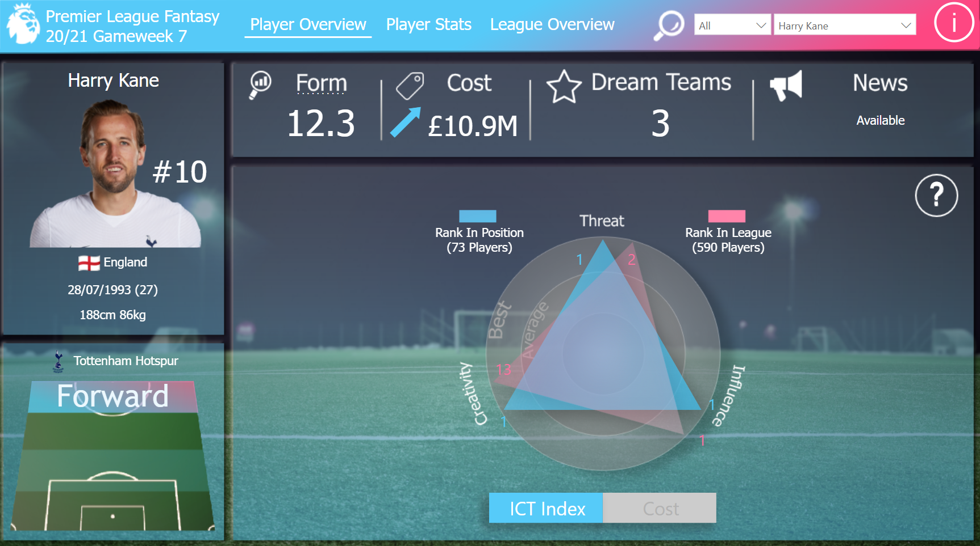
SVG elements
Source

Slide 15
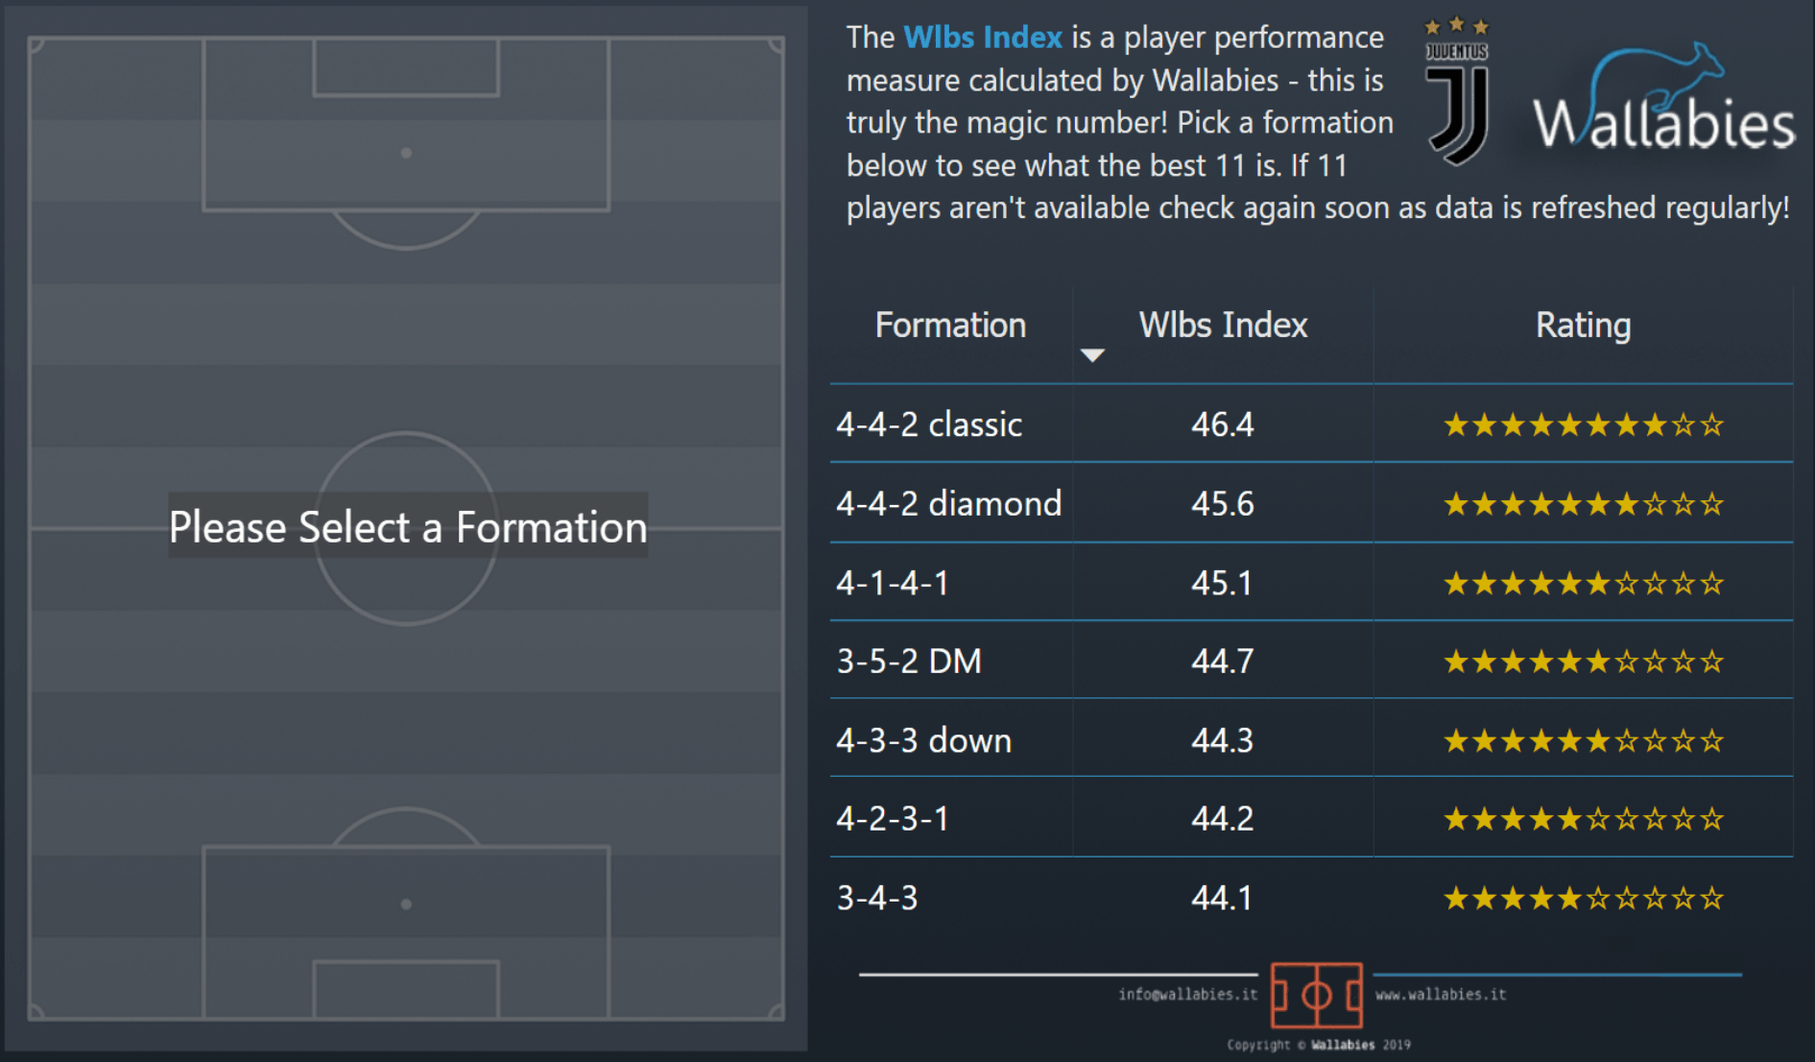
SVG elements
Source

Slide 16
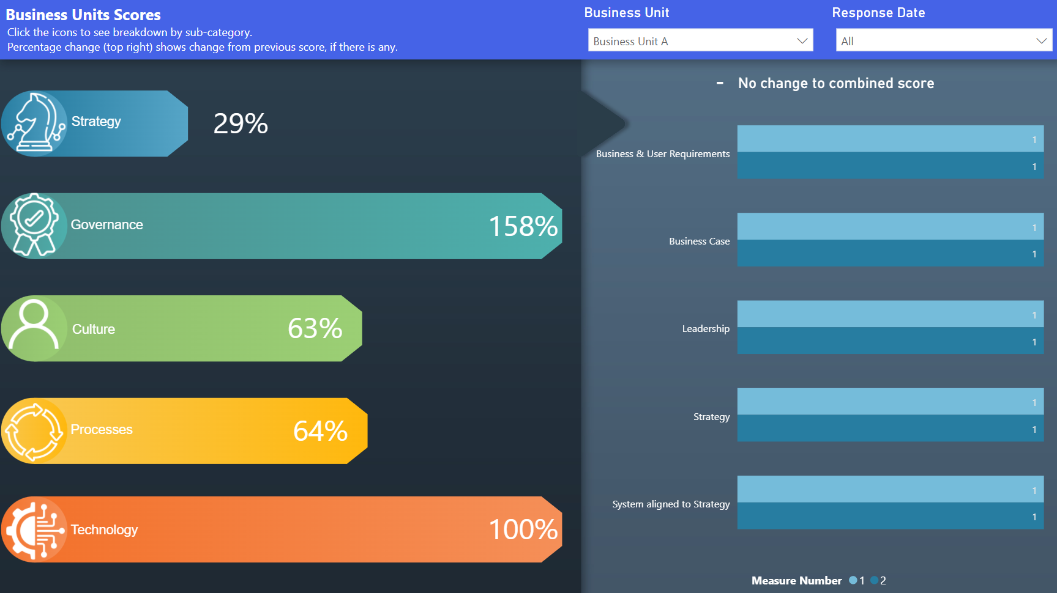
SVG elements
Source

Slide 17
Power BI visuals SDK
5

Slide 18
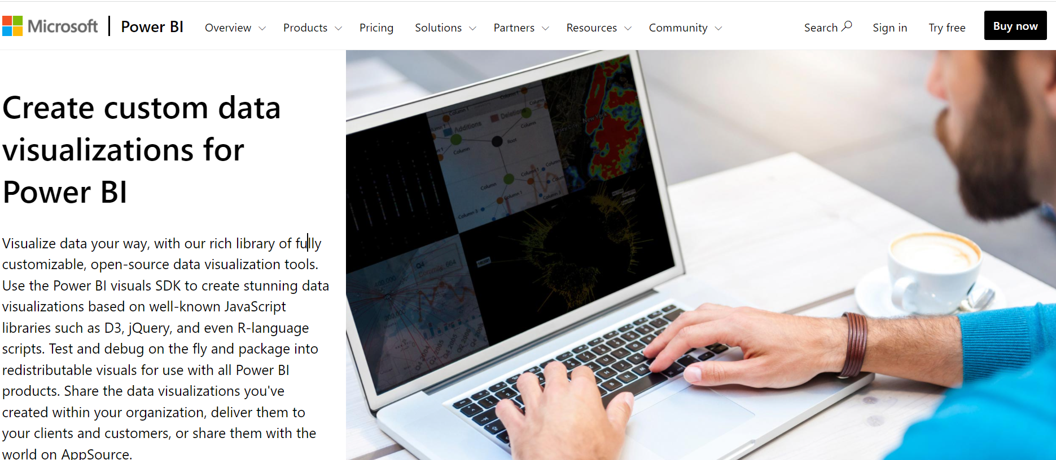
Power BI visuals SDK
Source

Slide 19
Thanks!
Any questions ?
You can find me at:
Flavio Meneses
flavio@bievolution.co.uk
https://bievolution.co.uk/
Presentation template by SlidesCarnival

